Slide 1
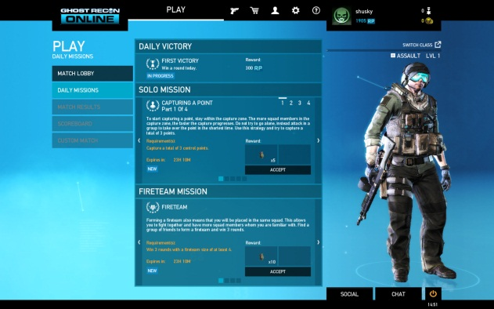
Script: (Agent name) we have a serious problem. The evil villains are working to crack the code for world domination. Your mission is to crack the code before they do. Are you ready?
Welcome to Crack the Code!
Scene 1 – Mission impossible style background/briefing.

Slide 2
Mission Possible!
Mission 1: Crack the Code
Mission Briefing
Mission Outcome
Mission 2: TBD
Mission Briefing
Mission Outcome
Mission 3: TBD
Mission Briefing
Mission Outcome
Mission Selection
Start
Notes:
Click Actions:
Start – If selected will take the user to the character selection screen slide 5
Mission Briefing – If selected will expand the box as shown in slide 3
Notes for Scene:
During this scene it would be nice to have some mission impossible type music in the background.
Would be cool as well to see the characters that they have to choose from in the background of this scene with a city or something in the background. Magenta style like the city they will see at the end of the game. Buildings will be black with magenta lighting. Maybe it would spell something in the lights like “Team Magenta”

Slide 3
Mission Possible!
Mission 1: Crack the Code
Crack the Code Mission Briefing:
During this mission, you will work against the clock to crack the code and save the world from world domination. Your task, identify the problem and apply a long term solution.
Mission Outcome
Mission 2: TBD
Mission Briefing
Mission Outcome
Mission 3: TBD
Mission Briefing
Mission Outcome
Mission Briefing Screen
Start
Notes:
Click Actions:
Start – If selected will take the user to the character selection screen. Slide 5
Mission Briefing – If selected will expand the box and take them to the mission briefing screen.
Notes for Scene: During this scene it would be nice if the mission briefing came up with a sound like it was being typed and having the briefing appear as if it is being typed.
This part was mentioned on previous scene notes: Would be cool as well to see the characters that they have to choose from in the background of this scene with a city or something in the background. Magenta style like the city they will see at the end of the game. Buildings will be black with magenta lighting. Maybe it would spell something in the lights like “Team Magenta”

Slide 4

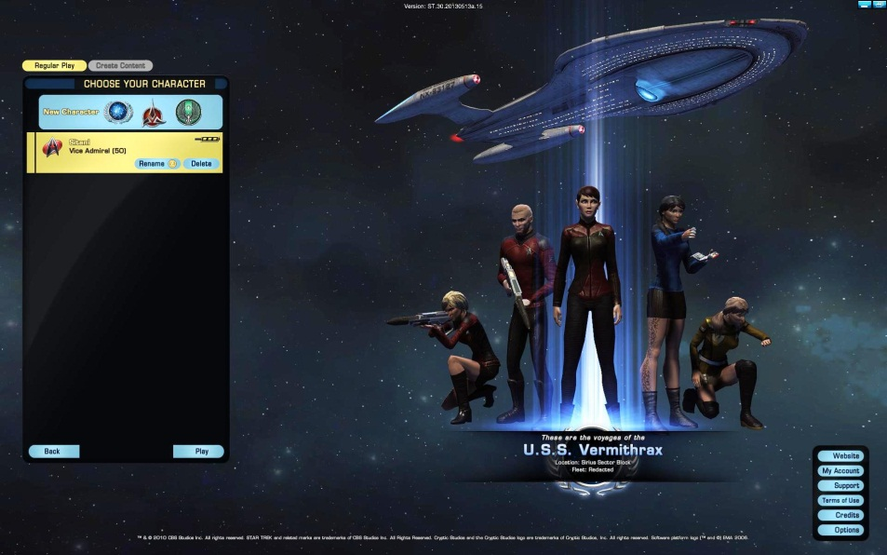
Script: Before we begin, let’s select a character
Scene 2– Image will have character options for them to choose from

Slide 5
Before we begin, you will need to select a character from the options below
Agent Magenta
Character Selection Screen
Next
Notes:
Click Actions:
Character: When a character is selected, the person will be enlarged on the screen.
Next: When you click on the start button, the person will go on to the next screen with the last character that was selected. Slide 7
Notes for Scene: Would be nice to have the characters designed off of a relaxed Legere like style but with a secret agent feel. Have him in a t-shirt and jeans. I’m not sure if that fits the secret agent feel so I’ll let you as the artist determine the end look but should include some magenta in the look without being over the top.
If the user selects the character, they should be able to zoom in if they want to see the image closer.

Slide 6
Script: Now that you’ve selected a character, let’s select an agent name.
Scene 3 – Agent name generator or a space for them to enter their agent name that will be used throughout the WBT.

Slide 7
Now that you’ve selected a character, let’s select an agent name
Type Agent name here
Agent Name Screen
Next
Notes:
Click Actions:
Agent Name box – When you click on the agent name box, the user will be able to type the name for the agent to be used throughout the game.
Next – Click the start box to proceed to the next screen slide 9
Notes for Scene:
There should be a box for the User to type in a name and once complete, the agent name will appear throughout the mission.

Slide 8
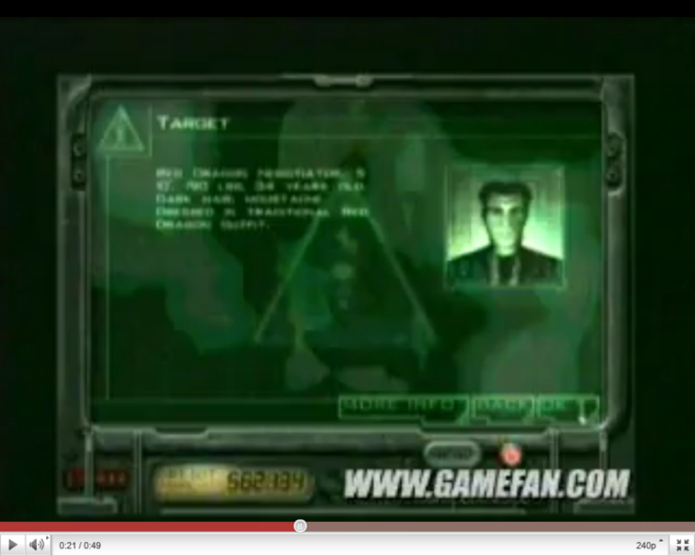
Script: Our organization has identified three individuals that are responsible for taking advantage of the community. These individuals are a huge threat to society. (names something that references red, yellow, and blue b/c of the competition. They are after the same key you are. If you find the key before they do, you will save the world from corruption.
Scene 5 – image of a targets.

Slide 9

Scene Note: This transparency box represents the background image for the scene. It would be nice to have the scene in the background of the image.
Mission details: Our organization has identified three individuals that are a threat to society. (names something that references red, yellow, and blue b/c of the competition. They are after the same key you are. If you find the key before they do, you will save the world from corruption.
Scene NOTES: Image of the enemies will be a person with Red gear, blue gear and yellow gear. Would be nice to dress each one like the sales people uniforms for the corresponding company. Not sure if we have any legal issues if we do that.
Insert Key here
Enemies
Previous
Enemies and Target
Next
Notes:
Click Actions:
Next button – Proceed to the next screen Slide 11
Previous button – Proceed to the previous screen Slide 7
Key – Selecting the key will enlarge the image and reduce the size to normal if selected again
Enemies – Selecting the enemies will enlarge the image and reduce size to normal if selected again
Mission details - Selecting the mission details will enlarge the image and reduce size to normal if selected again
Scene Notes:
Here would be images of the competition. As we talked they can be silhouettes with hints of red, blue, and yellow to represent our competition. They are only in this scene.
The key will be a hotel type key like we discussed with RC in the design some how. So maybe the key is magenta with RC in black design on the card or the key is black with Magenta design on the card.
For the background of this image have a scene of the area in the background or image of the inside of the building.
When the mission details are coming out have the sound of morse code and the image would zoom in on the competition as the details are being received. Typed out like the mission briefing scene…

Slide 10
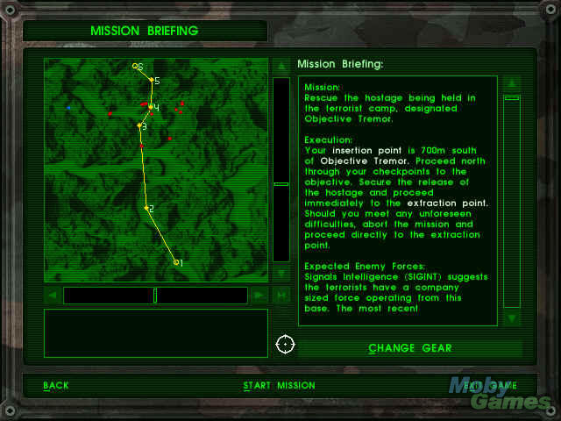
Script: Here is a map of the area. There are several clues that can be found along the way. Make sure you check out each clue before moving on as each clue will provide more information to help you crack the code.
Scene 4 – this scene will contain a map of the area.

Slide 11
MAP
Door to the City
Map
Instructions:
Here is a map of the area. Find the safe and crack the code. If you crack the code you will save the country from disruption.
Computer Room
Safe
You are here
Previous
NES style mission briefing
Next
Notes:
Click Actions:
Next – Proceed to the next screen. Slide 14
Map – Enlarge map and reduce size after second click.
Previous – Slide 9
Notes for Scene:
This scene could have a far out look where we are looking at the city and then it zooms in to a particular building (the one where the mission will take place) then they will show the map for the building in which it shows the map listed above where it points to where you are and where the safe is in the building.

Slide 12
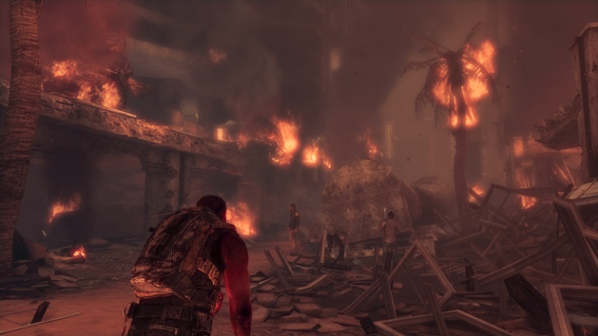
Script: Hurry they are taking over the city. If you can’t stop them they will take over the world.
Scene 6 – image of a person approaching our agent explaining the situation to them.

Slide 13
Alternate Script: AHHH! (yelling) They are coming. Please agent name you have to help. If you don’t crack the code before they do, everyone will pay.
Alternate Scene 6 – image of a person running and approaching our agent explaining the situation to them.

Slide 14
Scene Note: During this scene, the person will be looking right at the camera as if they were talking to us. The background/scene image would be here as well.
AAAHHHH! (Yelling) They are coming. Agent Name you have to help! If you don’t crack the code before they do, everyone will pay.
Agent name, I’m agent williams. I’m from the agency and will assist you along the way.
Previous
Start of the mission
Next
Notes:
Click Actions:
Next – Proceed to the next screen slide 15
Previous – Proceed to previous screen slide 11
Scene Notes:
During this scene this would be a by stander that is yelling for the agent to save them. The name would need to follow through from the beginning of the game when they named their agent. The person would be looking at the screen as they are talking. From there the agent would need to have a way to move them to the next screen. The person from the next screen will come introduce himself at this time.

Slide 15
Agent name the safe is in here. Hurry!
Previous
Hallway Scene – 1st safe
Next
Notes:
Click Actions:
Previous – Proceed to the previous screen Slide 14
Next – Proceed to the next screen Slide 16
Notes for Scene:
This character will need to be introduced in the last screen before this scene occurs. In this scene, the person will be using the agent name again and lead them to a hallways in which there is a door open for them to go into the room.

Slide 16
The safe contains the key to ending corrupting as we know it. You must crack the code to get access to the key. Get all the answers right and you will crack the code.
Safe
Scenario: Can’t make calls at home
Probing Questions
Root Cause
Solution
Previous
1st Safe Scene
Next
Notes:
Click Actions:
Probing Questions - Open slide 17
Root Cause – Open slide 18
Solution – Open slide 19
Previous – Proceed to the previous screen 15
Next – Proceed to the next screen (but only after all questions have been answered) Slide 20
Scene Notes:
This scene will have a safe that is in a room. For the safe image, there will be an activity for them to complete. The instructions will be at the top of the screen. Each box will open up and allow them to answer questions. When they get to the solution step and place their answer in the box. The helping character will come into the scene and say “It’s a trap”

Slide 17
Instructions: Using the scenario below, you must correctly identify the answers for the 3 categories below.
Safe
Scenario: Can’t make calls at home
Probing Questions
Root Cause
Solution
Choose the 3 most impacting questions you could start off with:
Previous
1st Safe Scene – Probing Question Selection
Next
Notes:
Click Actions:
Answers
Probing Questions, Root Cause and Solution boxes will not be allowed to be selected if the question is NOT answered.
Previous – Proceed to the previous screen 15
Next – Proceed to the next screen (but only after all questions have been answered) Slide 20

Slide 18
Here’s the safe. Crack the Code to access the safe. The safe contains the key to ending corrupting as we know it.
Safe
Scenario: Can’t make calls at home
Probing Questions
Root Cause
Solution
Choose the appropriate root cause:
Previous
1st Safe Scene – Root Cause Selection
Next
Notes:
Click Actions:
Answers
Probing Questions, Root Cause and Solution boxes will not be allowed to be selected if the question is NOT answered.
Previous – Proceed to the previous screen 15
Next – Proceed to the next screen (but only after all questions have been answered) Slide 20

Slide 19
Here’s the safe. Crack the Code to access the safe. The safe contains the key to ending corrupting as we know it.
Safe
Scenario: Can’t make calls at home
Probing Questions
Root Cause
Solution
Choose the appropriate solution (make sure you think long term and not short term):
Previous
1st Safe Scene – Solution Selection
Next
Notes:
Click Actions:
Answers
Probing Questions, Root Cause and Solution boxes will not be allowed to be selected if the question is NOT answered.
Previous – Proceed to the previous screen 15
Next – Proceed to the next screen (but only after all questions have been answered) Slide 20

Slide 20
Read Scene notes: This is transition screen that shows agent and helper are standing outside of the door when a bomb goes off and sound it played.
It’s a trap! The safe is going to self destruct. We have to get out of here.
Safe
Room collapse – We have to go
Next
Notes:
Click Actions:
Previous – Previous button will not be visible on this screen
Next – Proceed to the next screen slide 22
Scene Notes:
Helper is telling you it’s a trap. The scene will have the safe and the room they are in. The transition screen will need to have something showing them leaving the room or outside of the room. Maybe both standing up against the door closed and the sound of a bomb going off.

Slide 21
There is another safe on the other side of the building. Make sure you stop at the clue areas to gather as much information this time before you try to crack the code.
Previous
Hallway Scene – Map briefing on another safe
Next
Notes:
Previous – Proceed to the previous screen Slide 21
Next – Proceed to the next screen slide 23
Scene Notes:
This image should be of the helper in the hallway outside the door where they just where when the bomb went off.

Slide 22
MAP
City Door
Map
Instructions:
Here is an updated map of the area. There are several clues that can be found along the way. Make sure you check out each clue before moving on as each clue will provide more information to help you crack the code. This map will appear at the top of the screen and can be accessed anytime to move to a new location on the map. Click on the location where you would like to go first? Keep in mind you cannot go to the city door until you have cracked the code.
Safe
Computer Room
Computer Room
Witness
Safe
You are here
Previous
NES style mission briefing
Next
Notes:
Click Actions:
Map – Map will be enlarged upon one click and decrease size on 2nd click
Previous – Proceed to the previous screen Slide 22
Next – Proceed to the next screen Slide 25
Scene Notes:
From this point on the map should be available in every scene for them to go back to. If they click on any of the dots (except the 1st safe) they will be shown a picture of the scene as if they are in the room. There will be another button that appears that says “go here” for them to move to that location. At this point the user will select the room in which they would like to go. They can go to any of the rooms except the safe where they were just at and the city door.

Slide 23
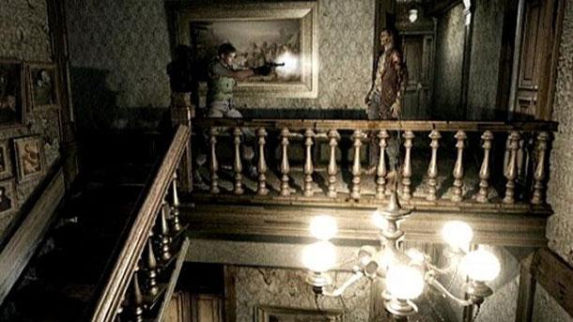
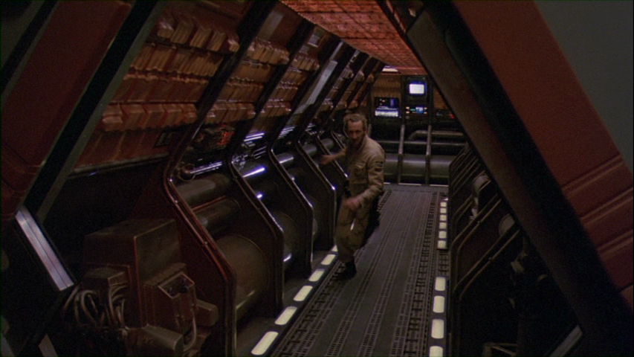
Script: Agent name quick this way. We found someone that witnessed the enemy corrupting our customers.
Scene 7 – Person approach our agent leading him to a room.

Slide 24
During this scene, the person will be looking right at the camera as if they were talking to us. The background/scene image would be here as well.
Agent Name quick this way. We found a witness that can help you with some information to crack the code.
Door that is open
Hallway
Previous
Hallway scene - Witness
Next
Notes:
Click Actions:
Previous – Proceed to the previous screen Slide 23
Next – Proceed to the next screen Slide 27
Scene Notes:
This is the first scene to introduce the witness scene. During this scene the helper will be leading the agent down the hallway to the room where the witness is located. As we get closer to the door it would be cool if we could fade music louder to simulate someone saying “Can’t anyone just help me!”

Slide 25


Script: We must get all the information from him as fast as we can. He has information you will need later to help crack the code.
Scene 8 – Person in a room. The person should look scared as if they just witnessed a horrific crime.

Slide 26
Video Placeholder – Video will provide importance of the FIX and probing questions along with instructions for the activity.
Instructions: We must get as much information from him as possible. Keep in mind he is not the enemy. It is important to treat him as part of the solution.
Situation
Duration
Location
Witness room
Next
Notes:
Click Actions:
Previous – Previous button will not be visible on this screen
Next – Proceed to the next screen Slide 29
Video – Video will play automatically and replay if clicked after it is over
Scene Notes:
Situation duration and Location images will become visible when mentioned in the video. They will populate based on a delay. The video will play automatically and based on the timing from the video when these items are mentioned, they will be timed to become visible as they are said in the video.
The character/witness should look stressed. Be sitting in a room with a desk in front of them. We would have a Samsung Galaxy S5 look alike phone in this scene to simulate a cell phone problem.

Slide 27

Instructions: Question can be broken down into three categories like the FIX. Situation, location, duration. Each category can provide different information. Choose the questions that will get you the most information.
Scene 9– Same person with light on them and question boxes displayed to pick from so we can choose the types of questions to ask.

Slide 28
These are going to be buttons and will open up to display questions that fall in that category.
Instructions: Effective probing questioning requires skill. The person gathering information should use both open and closed ended questions to gain the information they need. Remember this should not be an interrogation and the witness should be informed as to why you are asking the questions that you are. Choose your questions wisely to get the information you need efficiently and effectively. Each question will have a point value based on the information that it will gather.
This will be a picture of a backpack. After they ask their first question, this image will pop up and instructions will pop up as well telling them how to use this.
Situation
Duration
You now have access to your backpack. Every time you retrieve information, you can view it here by clicking on this image
Location
Previous
Witness room - Instructions
Next
Notes:
Click Actions:
Previous – Proceed to the previous screen Slide 27
Next – Proceed to the next screen Slide 34
Situation: Slide 31
Duration: Slide 32
Location: Slide 33
Scene Notes:
The character/witness should look stressed. Be sitting in a room with a desk in front of them. We would have a Samsung Galaxy S5 look alike phone in this scene to simulate a cell phone problem.
When the user clicks on one of the three categories, questions from that category will show up for them to select. They should just pop up over the image with the customer. Each of the categories will still need to be visible for the user to click on when already in another category. They also should be provided an answer for every question asked. For example: When Question 1 is selected, the user will be provided the answer to the question selected. This information will need to be saved and viewed later. At this point it would be nice to have a “backpack” in which the user can find what they’ve picked up a long the way. So if they click in the backpack, they can see the questions and answer to the question and if future scenes, access things they get from those scenes like information from resources and RC key at the Safe scene.
Each question that is asked is tracked. Questions will have a value on the backend so that we can track if they asked a lot of bad questions.

Slide 29
Instructions: Once you have enough information, click next to continue on.
Scene 10 – Same person with light on them and question boxes displayed to pick from so we can choose the types of questions to ask. Next button available to proceed to next scene

Slide 30
Instructions: Once you have the information you need, proceed to the next area.
Situation Questions will be listed here:
Situation
Duration
Location
Previous
Witness room – Situation Questions
Next
Notes:
Click Actions:
Previous – Proceed to the previous screen Slide 29
Next – Proceed to the next screen Slide 34
Situation: Slide 31
Duration: Slide 32
Location: Slide 33

Slide 31
Instructions: Once you have the information you need, proceed to the next area.
Duration Questions will be listed here:
Situation
Duration
Location
Previous
Witness room – Duration Questions
Next
Notes:
Click Actions:
Previous – Proceed to the previous screen Slide 29
Next – Proceed to the next screen Slide 34
Situation: Slide 31
Duration: Slide 32
Location: Slide 33

Slide 32
Instructions: Once you have the information you need, proceed to the next area.
Location Questions will be listed here:
Situation
Duration
Location
Previous
Witness room – Location Questions
Next
Notes:
Click Actions:
Previous – Proceed to the previous screen Slide 29
Next – Proceed to the next screen Slide 34
Situation: Slide 31
Duration: Slide 32
Location: Slide 33

Slide 33
Instructions: Once you have the information you need, proceed to the next area.
It looks like you have enough information. It’s time to find the computer room. We’ll be able to find more information there to help us crack the code.
Previous
Witness room – Enough Questions
Next
Notes:
Click Actions:
Previous – Proceed to the previous screen Slide 29
Next – Proceed to the next screen Slide 36
Scene Notes:
Helper is in the room and calls the agents attention to ask if they are ready to move on…. The scene will have the helper inside the witness room.

Slide 34
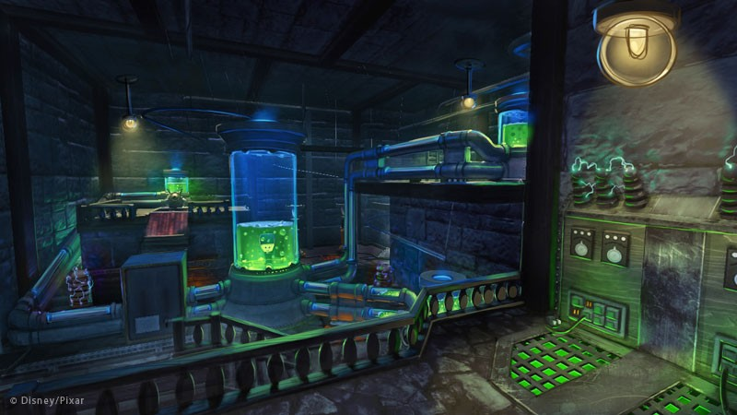
Script: Quick this door is open. Let’s take a look in this room and see what we can find. Looks like we have clues. HINT: It looks like there is some information we can gather from the computer. Let’s check it out.
Scene 11 – hallways with door open to data center and then once in the room the user will be able to choose to sit in front of a computer. The computer will have clues in which the user can select in order to gather additional information (Clues) – clues will be images of QV, Usage Summary, Memos, Samson, Agreement tab

Slide 35
During this scene, the person will be looking right at the camera as if they were talking to us. The background/scene image would be here as well.
Look over there! It’s the door to the computer room. Let’s go in and see what we can find.
Door that is open
Hallway
Previous
Hallway scene – Computer room
Next
Notes:
Click Actions:
Previous – Proceed to the previous screen Slide 34
Next – Proceed to the next screen Slide 37
Scene Notes:
The helper will be leading the agent down a hallway again and will see a door that is open. The hallway and the rooms should have papers on the floor showing a mess as if someone has been going through the building looking for something.

Slide 36
Look at this. The computer is on. Use your skills to navigate and help identify other clues to help crack the code.
Computer
Error
Table
Previous
Computer Scene
Next
Notes:
Click Actions:
Previous – Proceed to the previous screen Slide 36
Next – Proceed to the next screen Slide 38
Computer – Proceed to the next screen Slide 38
Scene Notes:
Helper would lead the agent into the room. The room would be rummaged through with papers on the ground and the computer on. The computer would be sitting on top of a table with the words “error” on the computer.

Slide 37
Video Placeholder – Providing Instructions for activity (Navigating to Tsing document)
Community Tsing Document
Table
Previous
Computer Scene – Access the Tsing document
Next
Notes:
Click Actions:
Video: Play automatically when entering this screen and replayed upon being clicked
Previous – Proceed to the previous screen slide 37
Next – Proceed to the next screen 39
Scene Notes:
Same scene as before only helper is not in this scene. After the video plays, the scene should zoom in on the computer so that the computer is the entire screen and the user it displayed with the next activity.

Slide 38
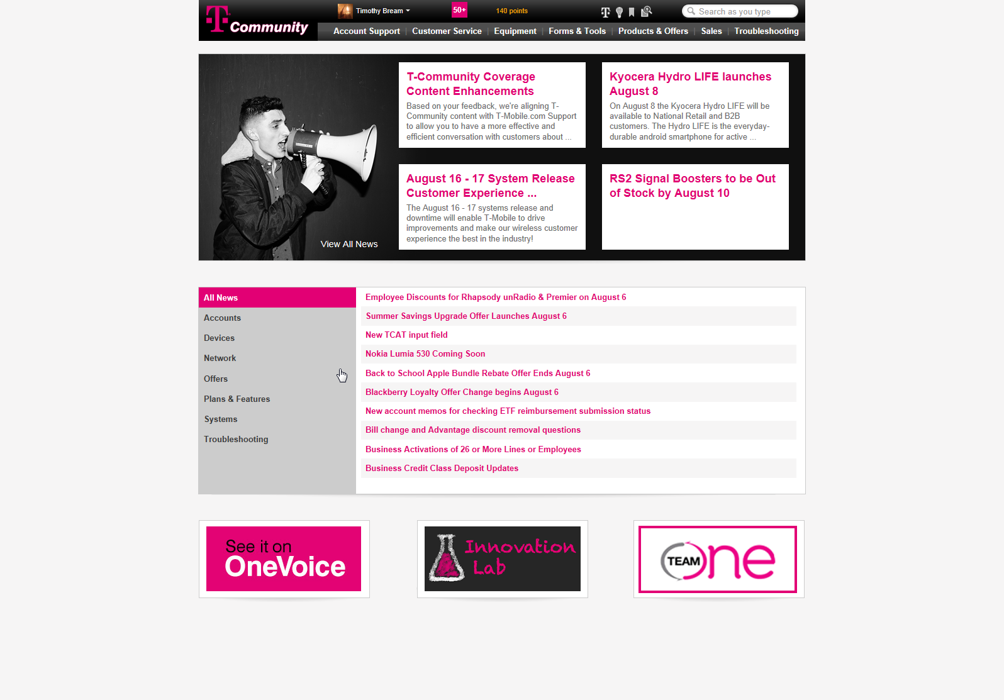
Instructions: Use the information you have gathered so far to navigate to the appropriate troubleshooting document that would be used to resolve the scenario.
Previous
Computer Scene – Community Navigation Activity
Notes:
Click Actions:
Previous – Proceed to the previous screen slide 38
Next – will not be visible during the navigation activity.
Troubleshooting – Proceed to slide 40
All other topic headings will provide feedback from feedback screen 46
Scene notes:
Backpack image should be displayed so that the user can go back to the questions they asked and see the answers that were provided, given that they chose to go to the witness room first.
During this activity the user will be navigating to the appropriate tsing document. The red boxes on the images indicate click actions and the slides they will go to are noted above. This is the same of the next few screens.

Slide 39
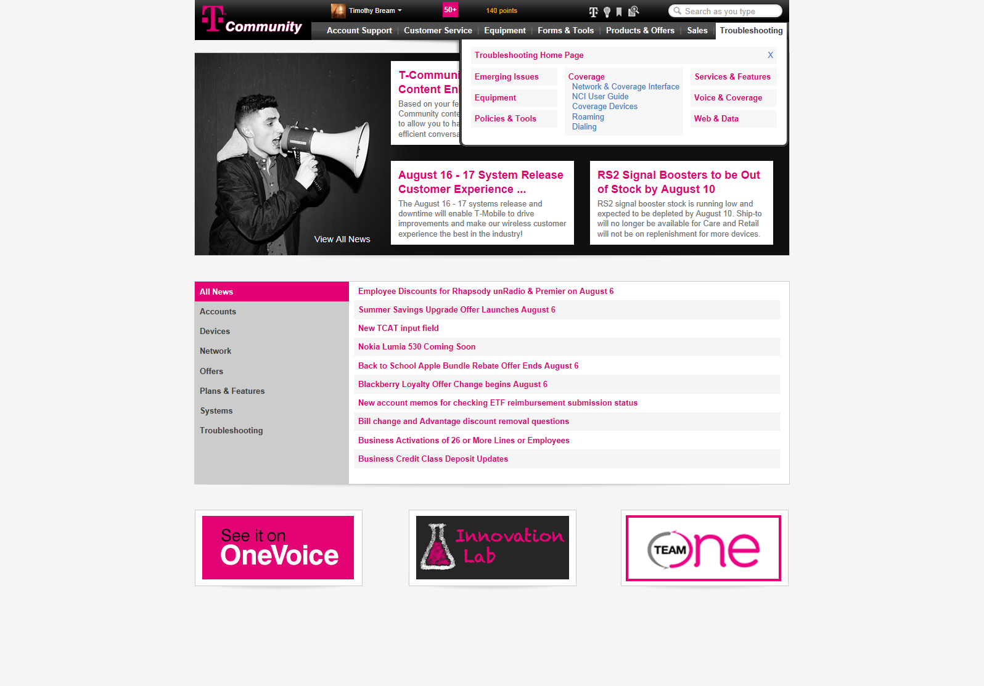
Computer Scene – Community Navigation Activity
Notes:
Click Actions:
Previous – will not be visible during the navigation activity
Next – will not be visible during the navigation activity
Troubleshooting Home Page – Proceed to slide 41
Voice & Coverage – Proceed to slide 43
Services & Features – Slide 42
Web & Data – Slide
All other topic headings will provide feedback from feedback screen 46

Slide 40
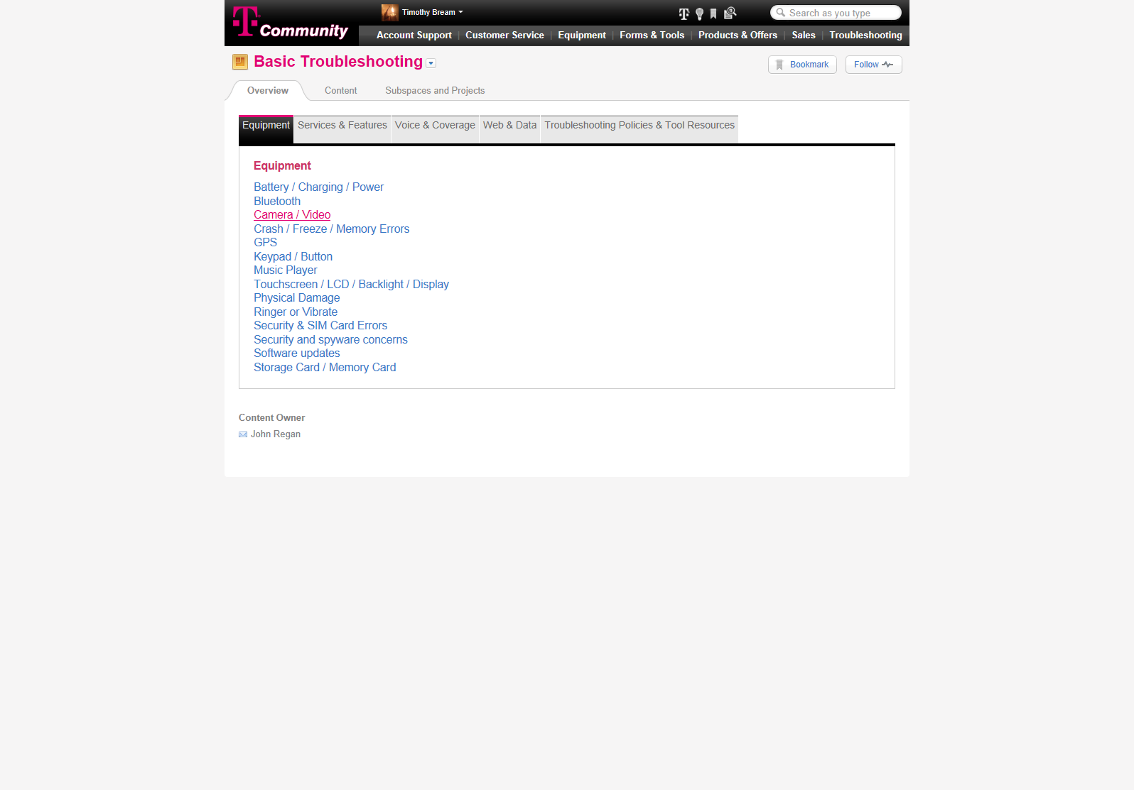
Computer Scene – Community Navigation Activity
Notes:
Click Actions:
Previous – will not be visible during the navigation activity
Next – will not be visible during the navigation activity
Voice and Coverage – Proceed to slide 43
Services & Features – Proceed to slide 42
Web & Data – Slide 44
Troubleshooting Policies & Tool Resources – Slide 45
All other topic headings will provide feedback from feedback screen 46

Slide 41
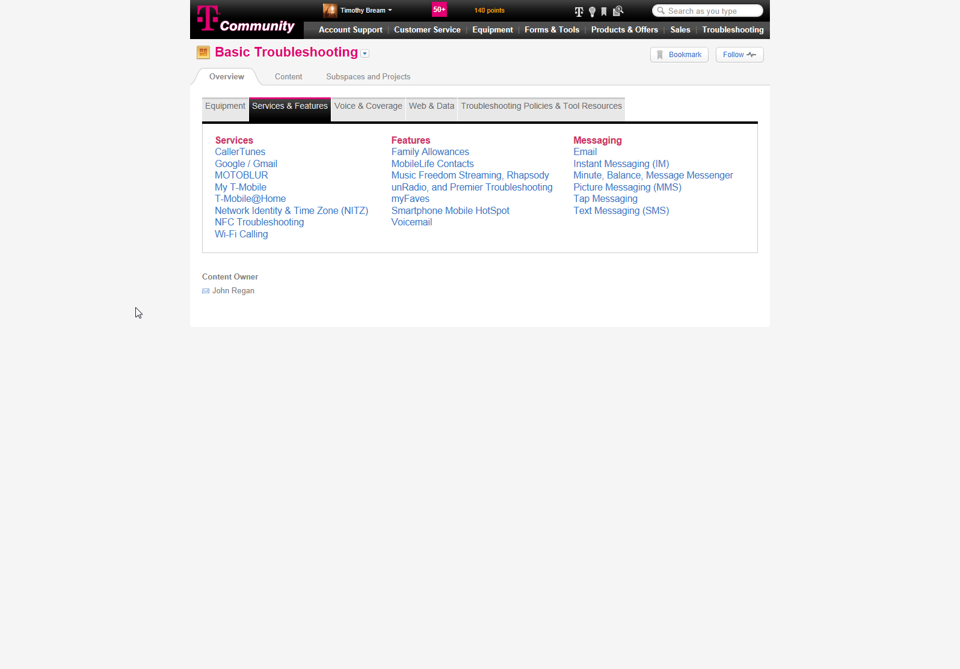
Computer Scene – Community Navigation Activity
Notes:
Click Actions:
Previous – will not be visible during the navigation activity
Next – will not be visible during the navigation activity
Equipment – Slide 41
Voice and Coverage – Proceed to slide 43
Services & Features – Proceed to slide 42
Web & Data – Slide 44
Troubleshooting Policies & Tool Resources – Slide 45
All other topic headings will provide feedback from feedback screen 46

Slide 42
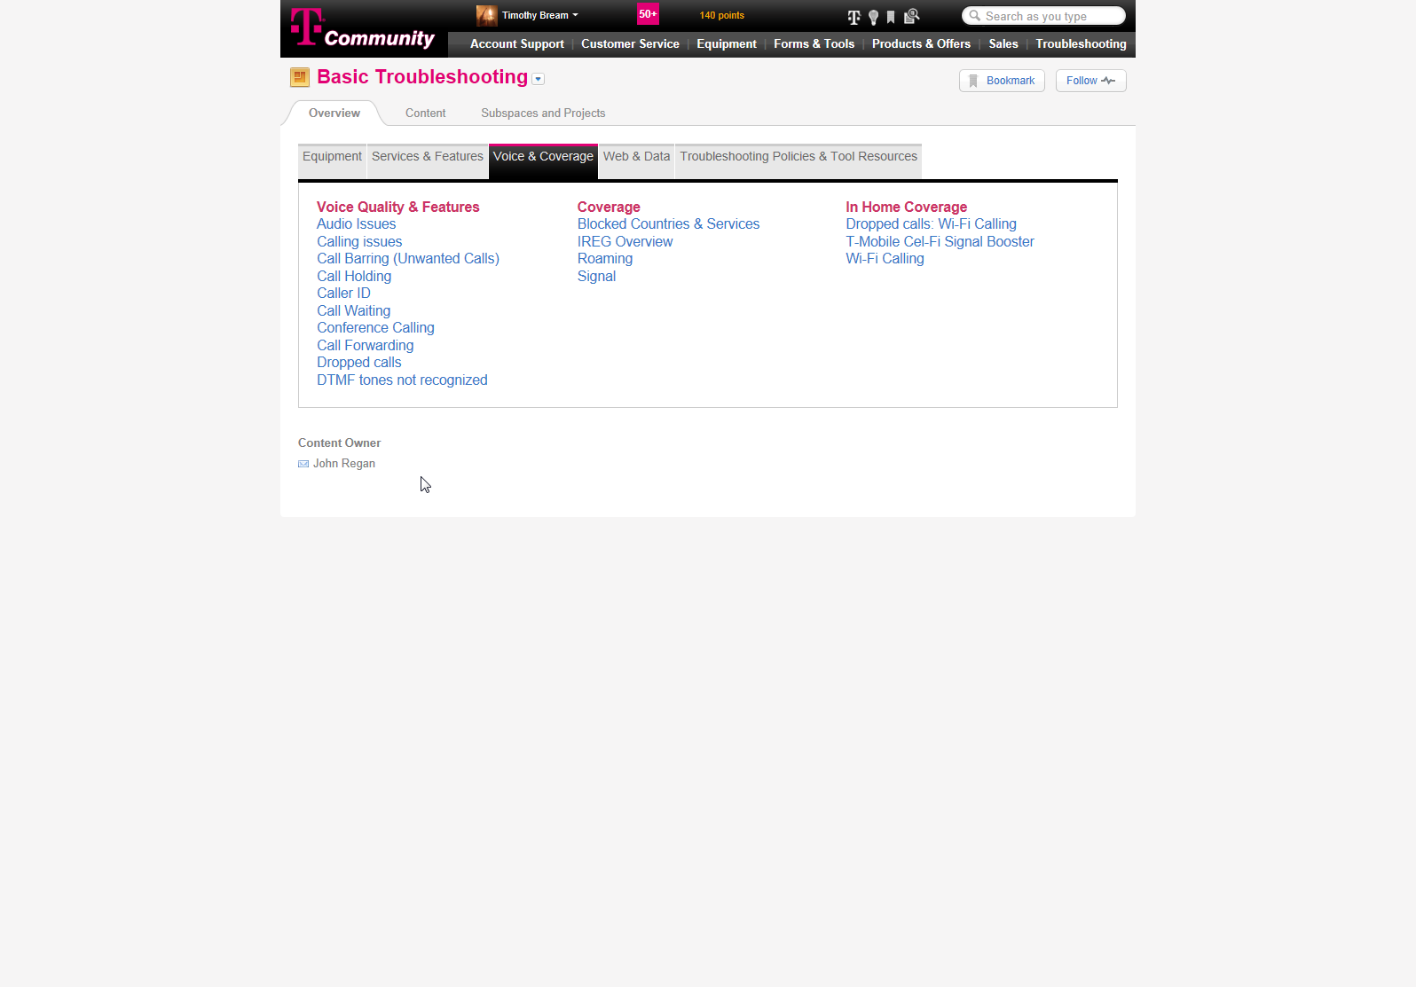
Computer Scene – Community Navigation Activity
Notes:
Click Actions:
Previous – will not be visible during the navigation activity
Next – will not be visible during the navigation activity
Equipment – Slide 41
Voice and Coverage – Proceed to slide 43
Services & Features – Proceed to slide 42
Web & Data – Slide 44
Troubleshooting Policies & Tool Resources – Slide 45
Signal – Slide 47
All other topic headings will provide feedback from feedback screen 46

Slide 43
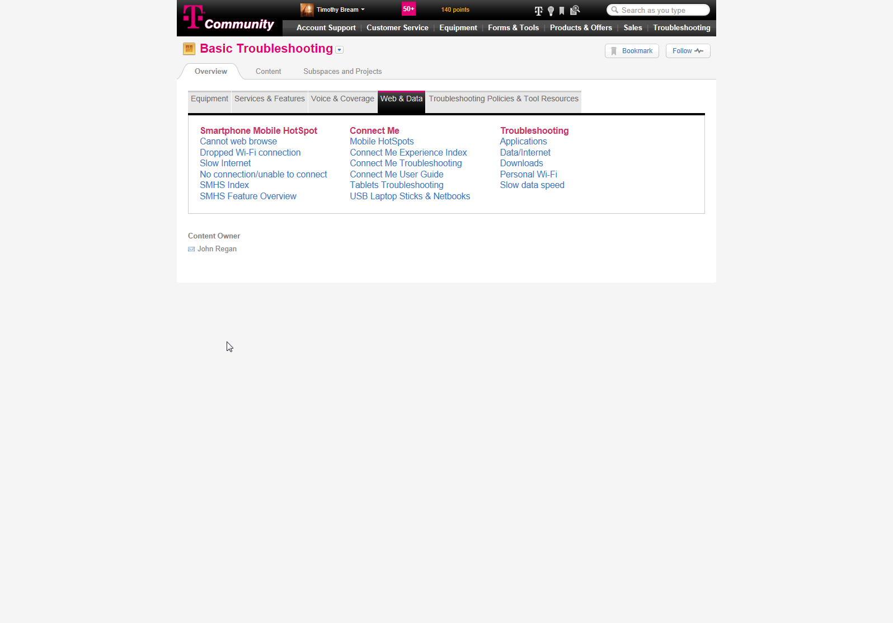
Computer Scene – Community Navigation Activity
Notes:
Click Actions:
Previous – will not be visible during the navigation activity
Next – will not be visible during the navigation activity
Equipment – Slide 41
Voice and Coverage – Proceed to slide 43
Services & Features – Proceed to slide 42
Web & Data – Slide 44
Troubleshooting Policies & Tool Resources – Slide 45
All other topic headings will provide feedback from feedback screen 46

Slide 44
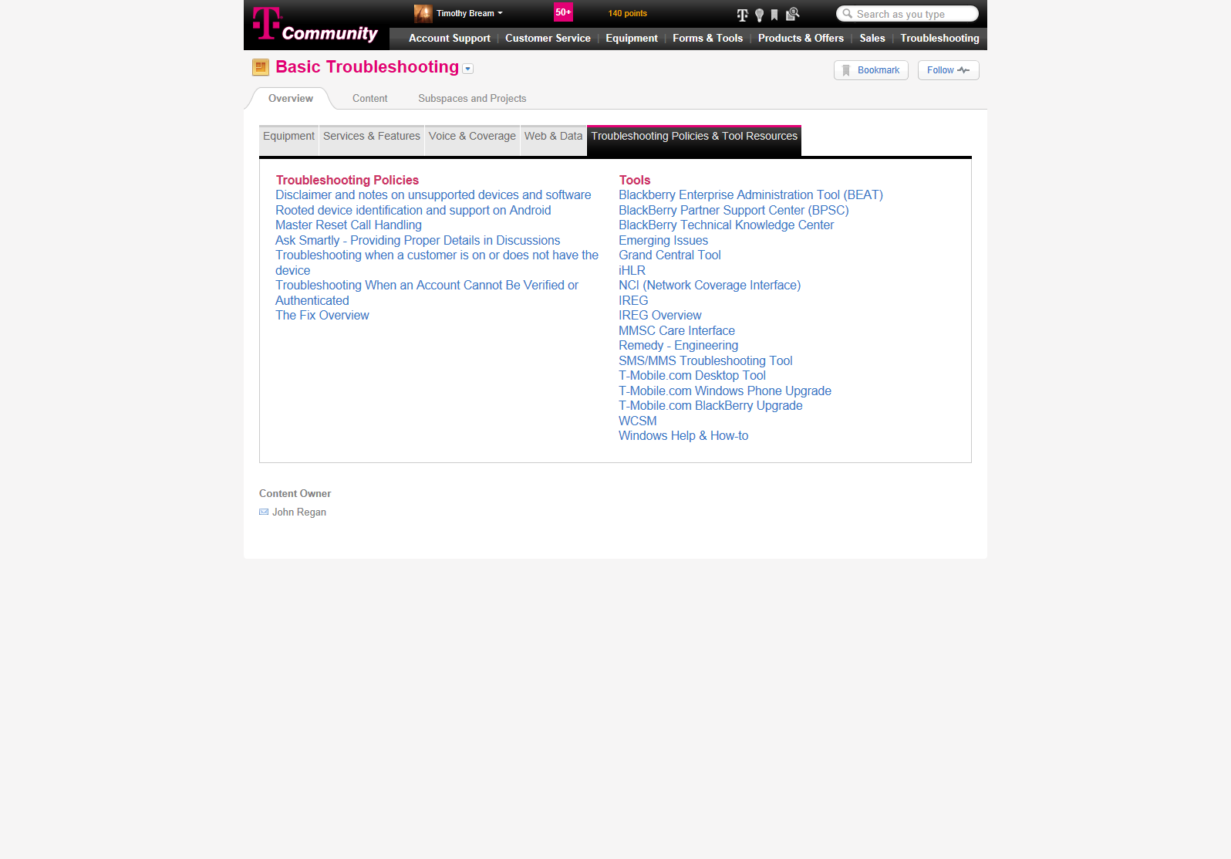
Computer Scene – Community Navigation Activity
Notes:
Click Actions:
Previous – will not be visible during the navigation activity
Next – will not be visible during the navigation activity
Equipment – Slide 41
Voice and Coverage – Proceed to slide 43
Services & Features – Proceed to slide 42
Web & Data – Slide 44
Troubleshooting Policies & Tool Resources – Slide 45
All other topic headings will provide feedback from feedback screen 46

Slide 45
Feedback: The instructions for this activity are to locate the Troubleshooting Document that contains all the steps to help troubleshoot the issue.
If you believe this feedback is incorrect, you may want to return to the witness room to ask additional questions and gather more information regarding the scenario.
Witness Room
Wrong Selection – Community Tsing Navigation Activity
Notes:
Click Actions:
Previous – Proceed to the previous screen – *****ASK MARK IF WE NEED TO CREATE FEEDBACK SCREENS FOR EVERY WRONG ANSWER SO THAT THE SYSTEM WILL KNOW WHERE THE LAST SCREEN WAS BEFORE THE WRONG ANSWER WAS SELECTED*****
Next – will not be visible during the navigation activity
Witness Room – Proceed to slide 29
Scene Notes:
This is the wrong selection feedback screen that will pop up if they click on a wrong answer.

Slide 46
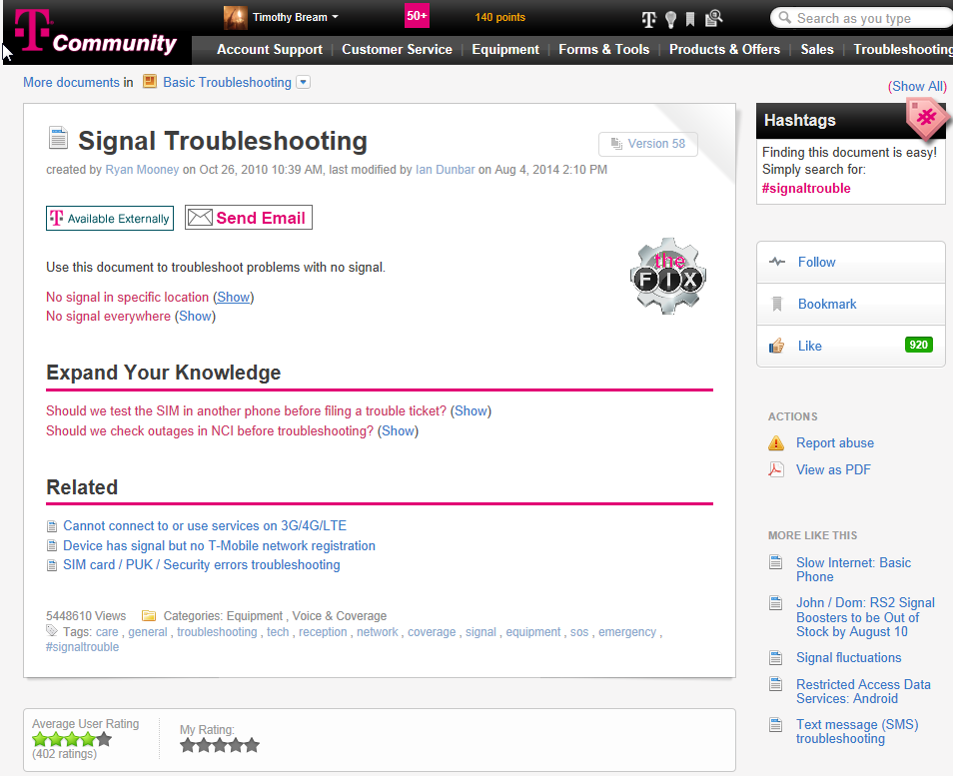
Pop Up BOX: Is the customer’s problem happening everywhere or just in a specific location. Don’t assume the answer to this question. Always ask. If we assume, we could end up spending time performing steps that are not necessary.
Computer Scene – Specific Location selection
Notes:
Click Actions:
Previous – will not be visible during the navigation activity
Next – will not be visible during the navigation activity
No Signal in Specific Location (Show) – Slide 48
All other topic headings will provide feedback from feedback screen 46
Scene Notes: A pop up box should be displayed on this screen.

Slide 47
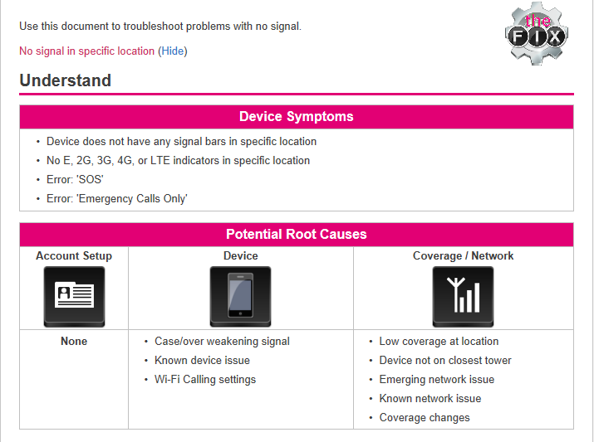
Device Symptoms pop up box: If a customer has signal in one location and not another, the device symptoms will include the following.
Potential Root Cause pop up box: If we asked enough questions and we determine that the customer does have signal in other locations but not in this specific location, the potential root causes that fall into three categories. Account setup issues (examples include: account status, missing features, wrong SIM number), Device Issues (Examples include: damaged phone, improper settings, known issue), and Coverage/Network (examples include: network outage, improper provisioning in iHLR, no coverage at the location). Probing questions, common procedures, and the use of tools will help eliminate possible causes and help us narrow in on the true issue.
Computer Scene – Device Symptoms and Root Cause discussion
Next
Notes:
Click Actions:
Previous – will not be visible during the navigation activity
Next – Slide 49
Scene Notes:
Once they select No signal in a specific location, this slide should appear. Zoom in on Device Symptoms and display pop up for device symptoms. They can then exit out of that zoom in box and the Potential root causes box will zoom in with appropriate pop up box for that sections and repeating experience as previous popup box.

Slide 48
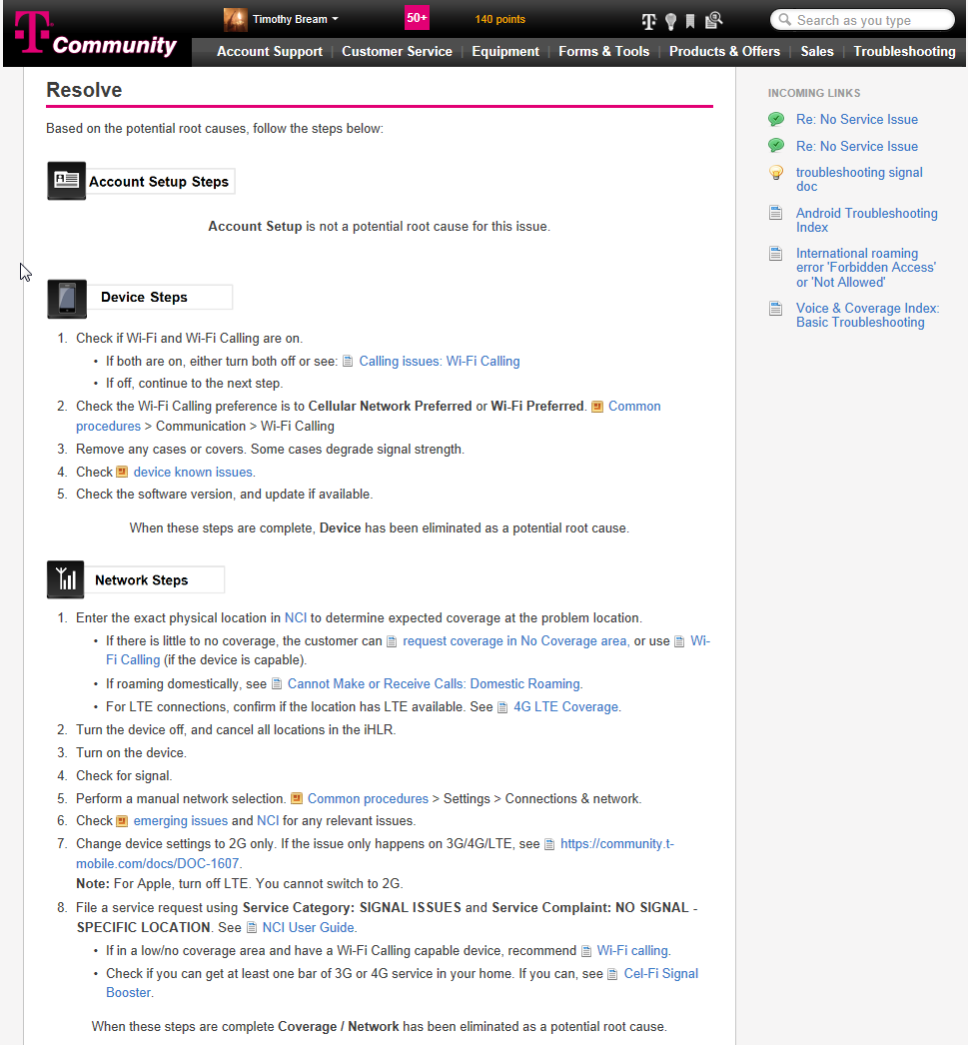
Popup Box: Under the resolve section of these troubleshooting documents, you will see steps broken down by potential root cause categories. As you can see there are no potential root causes that are found in the account setup section for this particular issue. If a customer only has a problem with signal in a particular area, it has to be caused by something that has to do with the device or something that found within the network. Based on your questions, you may want to focus on the network vs. the device steps depending on what you found during the probing questions activity.
Previous
Computer Scene – Resolve Conversation
Next
Notes:
Click Actions:
Previous – Slide 48
Next – Slide 50
Scene Notes:

Slide 49
The resolve section of the document contains the steps to take in order to resolve the issue. The steps are broken down into the root cause categories. Use the information you get from your probing questions to determine what steps to take first.
Community Tsing Document
Table
Previous
Computer Scene – Access the Tsing document
Next
Notes:
Click Actions:
Previous – Slide 49
Next – Slide 51
Scene notes:
This scene popup box will be displayed then the community image will move from full screen to half screen which end result will be shown in slide 51.

Slide 50
Previous
Computer Scene – Access the Tsing document
Notes:
Click Actions:
Community Document – Allow the CSR to resize the window. Outcome will be Slide 52
Previous – Slide 50
Next – Next button will not be visible as the action must be completed to proceed to next slide

Slide 51
Video Placeholder – Telling them instructions for the activity allowing them to use systems like QV, Samson, DMW
QuikView
Samson
Desktop Tool
iHLR
Handset Dashboard
NCI
Device Model Warranty Tool
IMEI Blocking Tool
Remedy
Common Procedures
Witness Information
Computer Scene – System Selection
Notes:
Click Actions:
Video – Video will automatically play and will be allowed to re-watch upon another click
Witness Information – Slide will need to be created with correct and incorrect answers
Samson –
QuikView –
Desktop Tool –
iHLR –
Handset Dashboard –
Device Model Warranty –
IMEI Blocking Tool –
Remedy –
NCI – Slide 53
Customer Steps -
Scene Notes:
Computer will have image of Samson, QV, and other tools for the Agent to view. If the agent picks an image that will not help them, they will receive feedback and will have a point value for each screen.

Slide 52
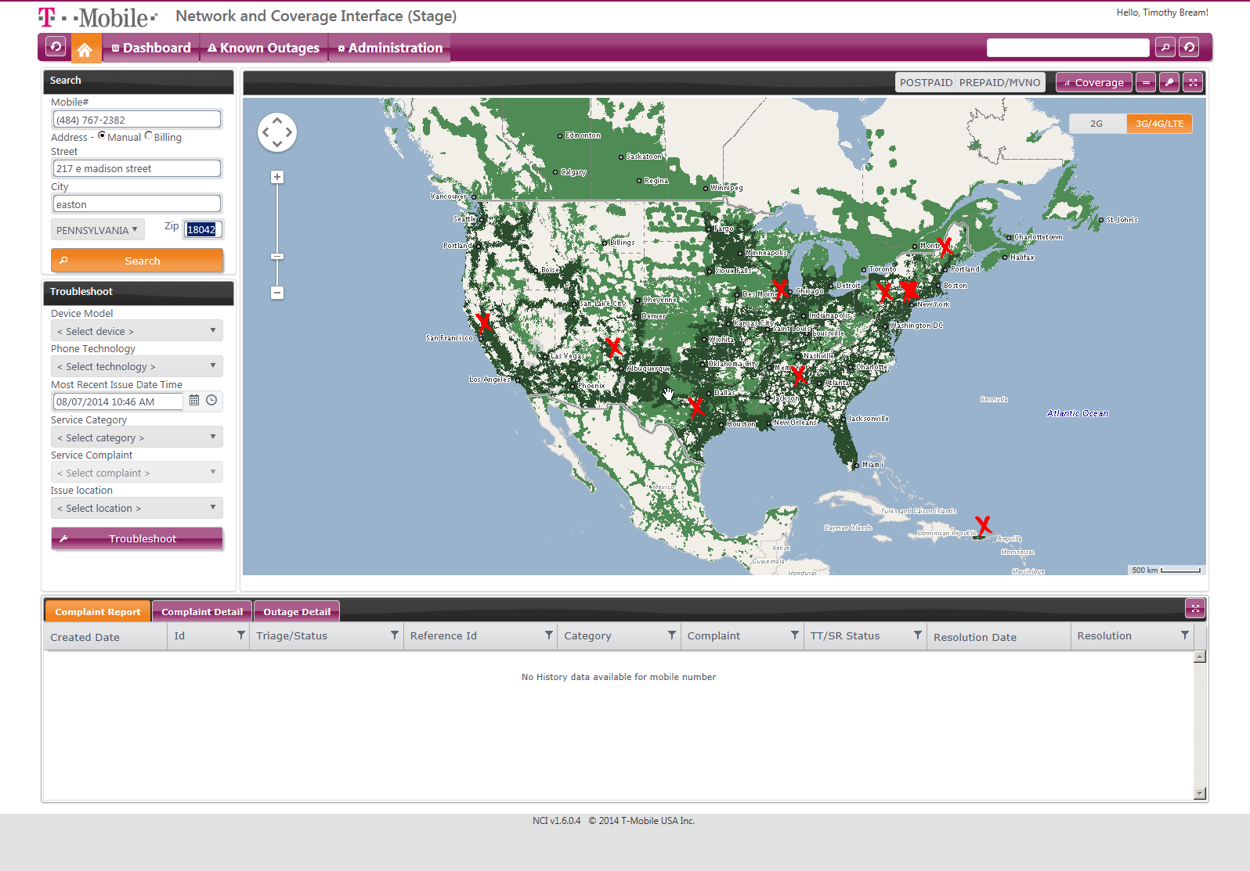
Notes:
Click Actions:
Search:

Slide 53
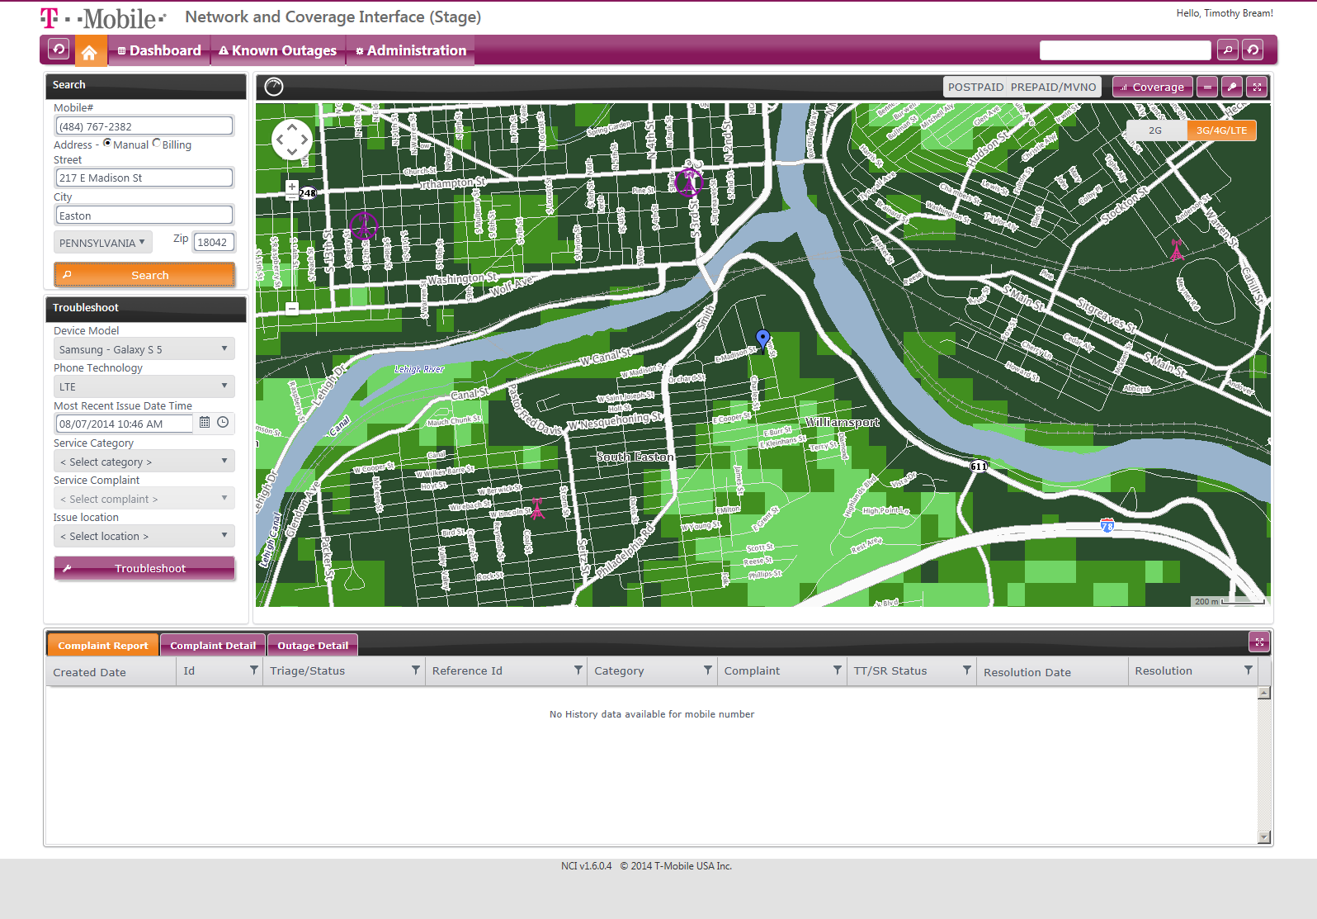
Notes:
Click Actions:
Known Outages: Slide 61
Coverage:
2G: Slide 55
3G/4G/LTE: Slide 56
Clock: Slide 58

Slide 54
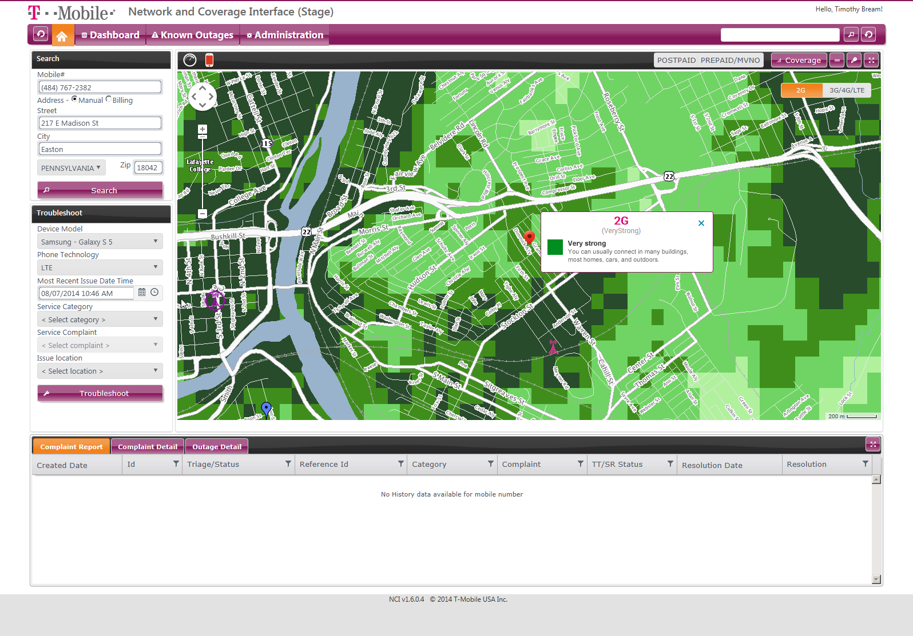
Notes:
Click Actions:
Known Outages: Slide 61
Coverage:
2G: Slide 55
3G/4G/LTE: Slide 56
Clock: Slide 58
Phone Icon: Slide 59

Slide 55
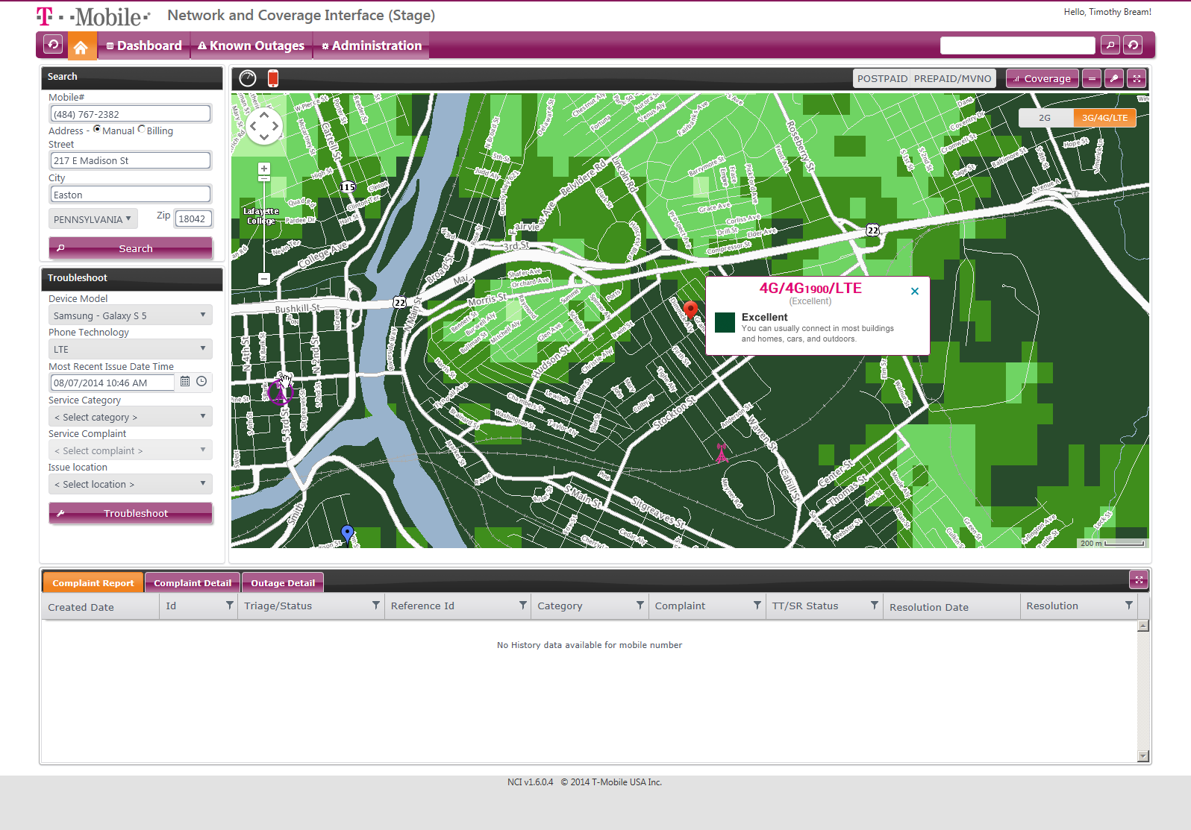
Notes:
Click Actions:
Known Outages: Slide 61
Coverage:
2G: Slide 55
3G/4G/LTE: Slide 56
Clock: Slide 58
Phone Icon: Slide 59

Slide 56
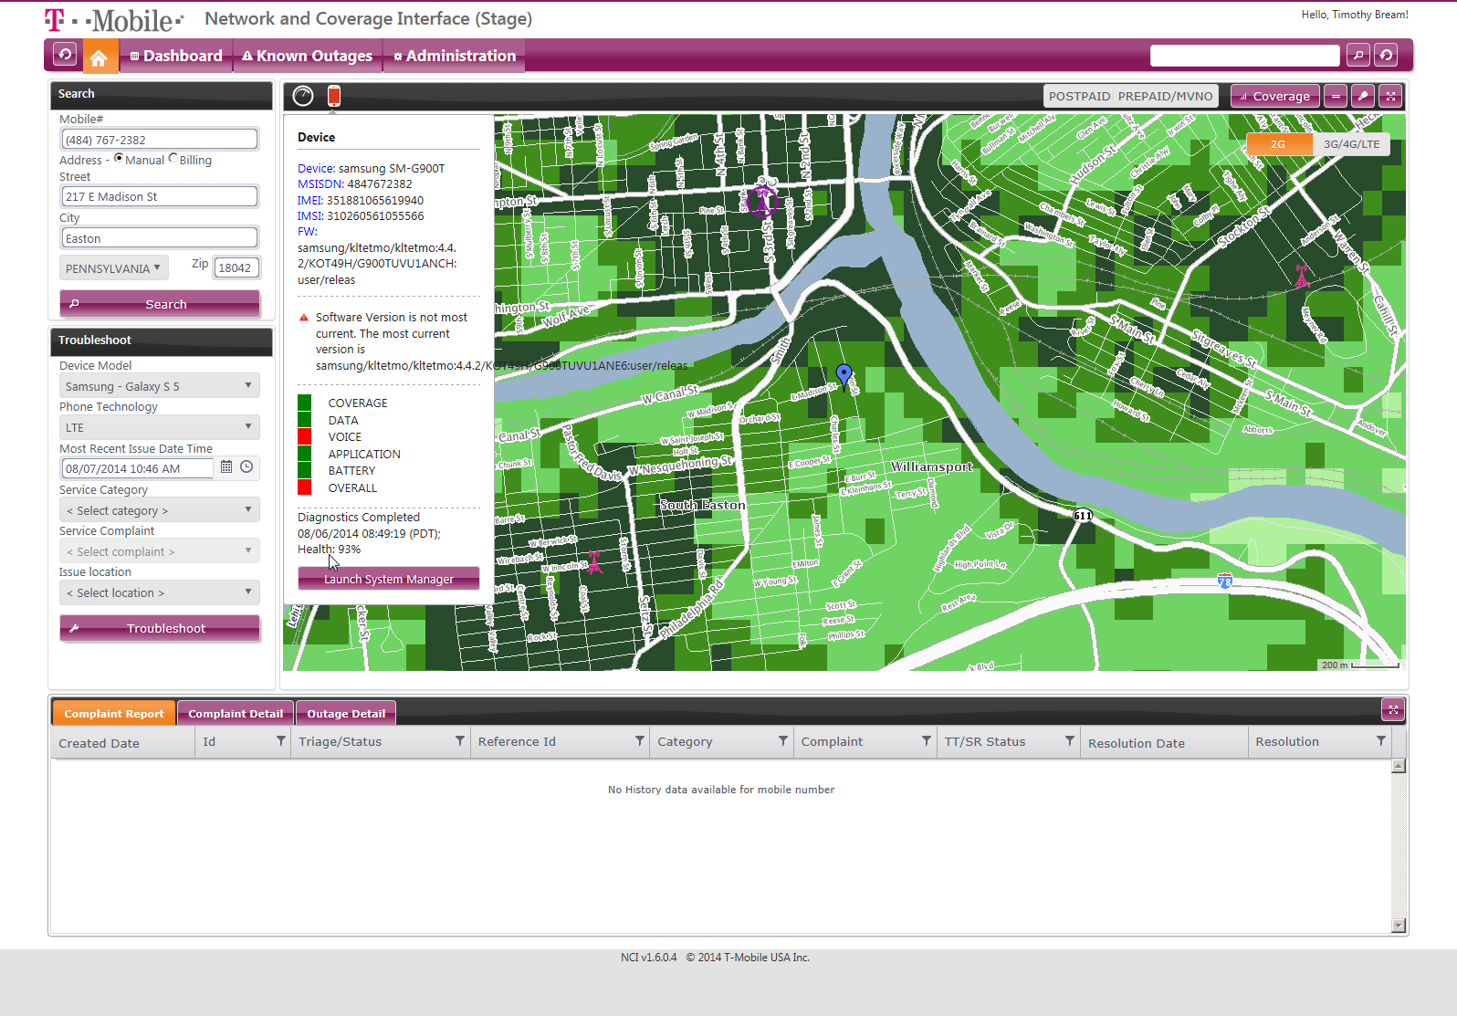
Notes:
Click Actions:
Known Outages: Slide 61
Coverage:
2G: Slide 55
3G/4G/LTE: Slide 56
Clock: Slide 58
Phone Icon: Slide 59

Slide 57
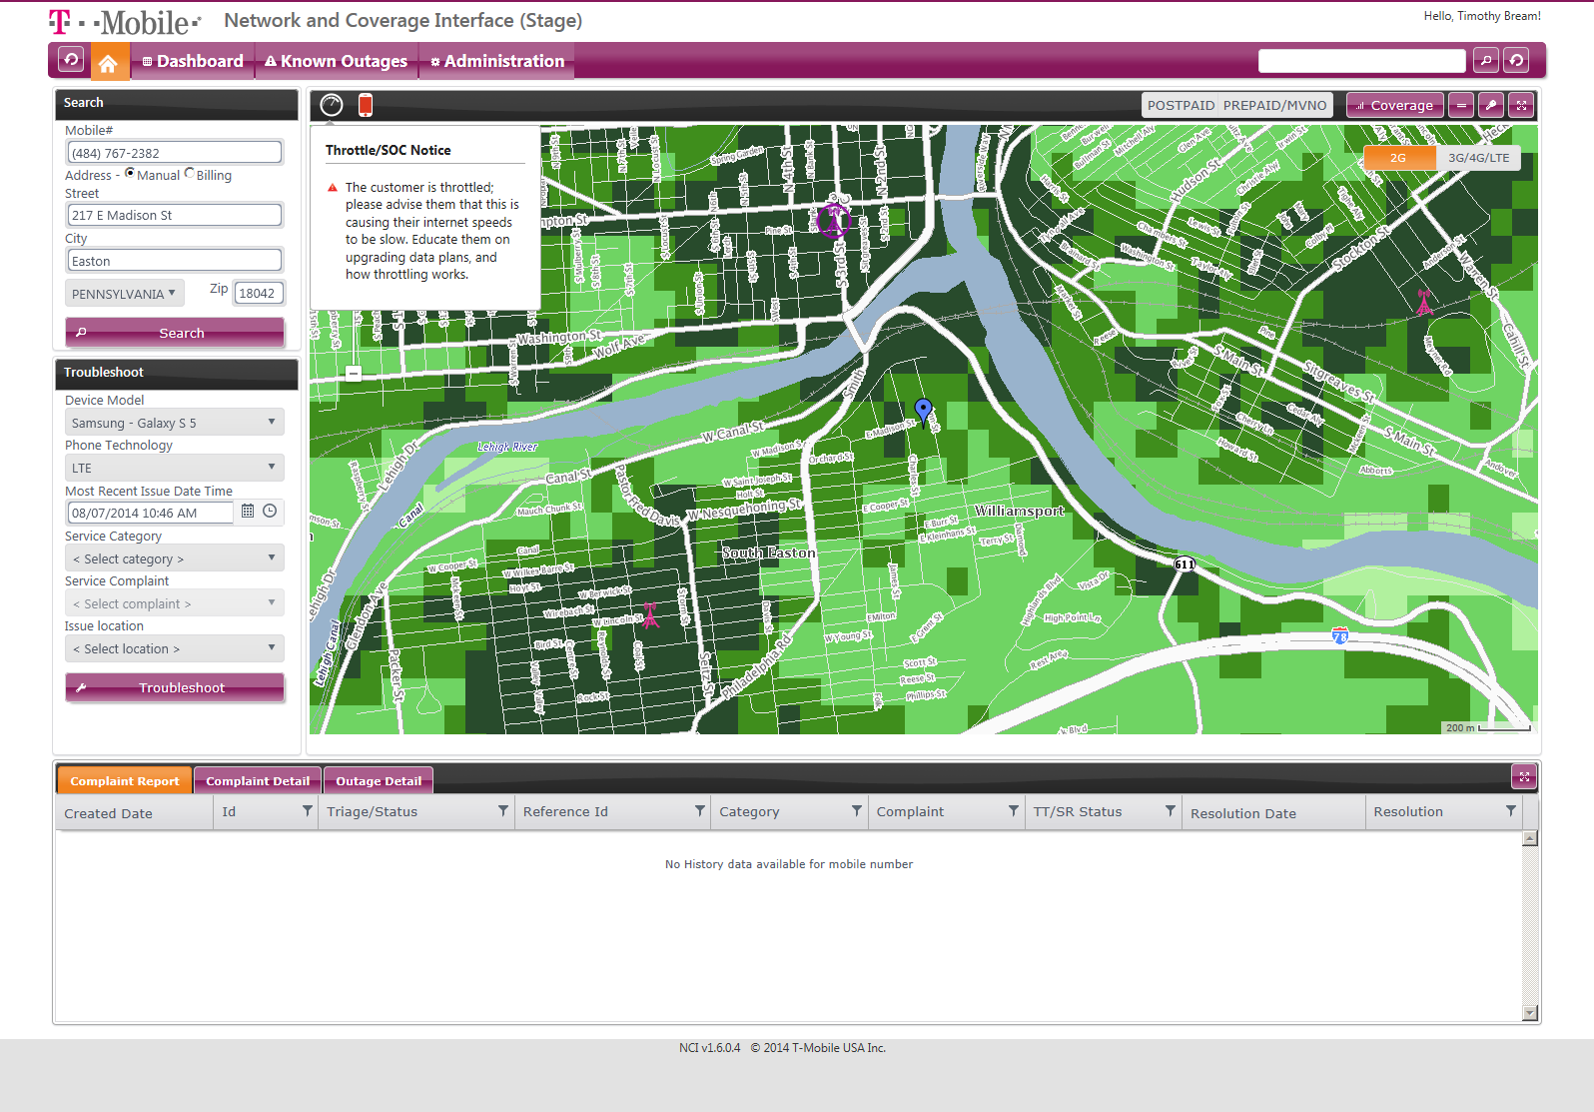
Notes:
Click Actions:
Known Outages: Slide 61
Coverage:
2G: Slide 55
3G/4G/LTE: Slide 56
Clock: Slide 58
Phone Icon: Slide 59

Slide 58
Notes:
Click Actions:
Known Outages: Slide 61
Coverage:
2G: Slide 55
3G/4G/LTE: Slide 56
Clock: Slide 58

Slide 59
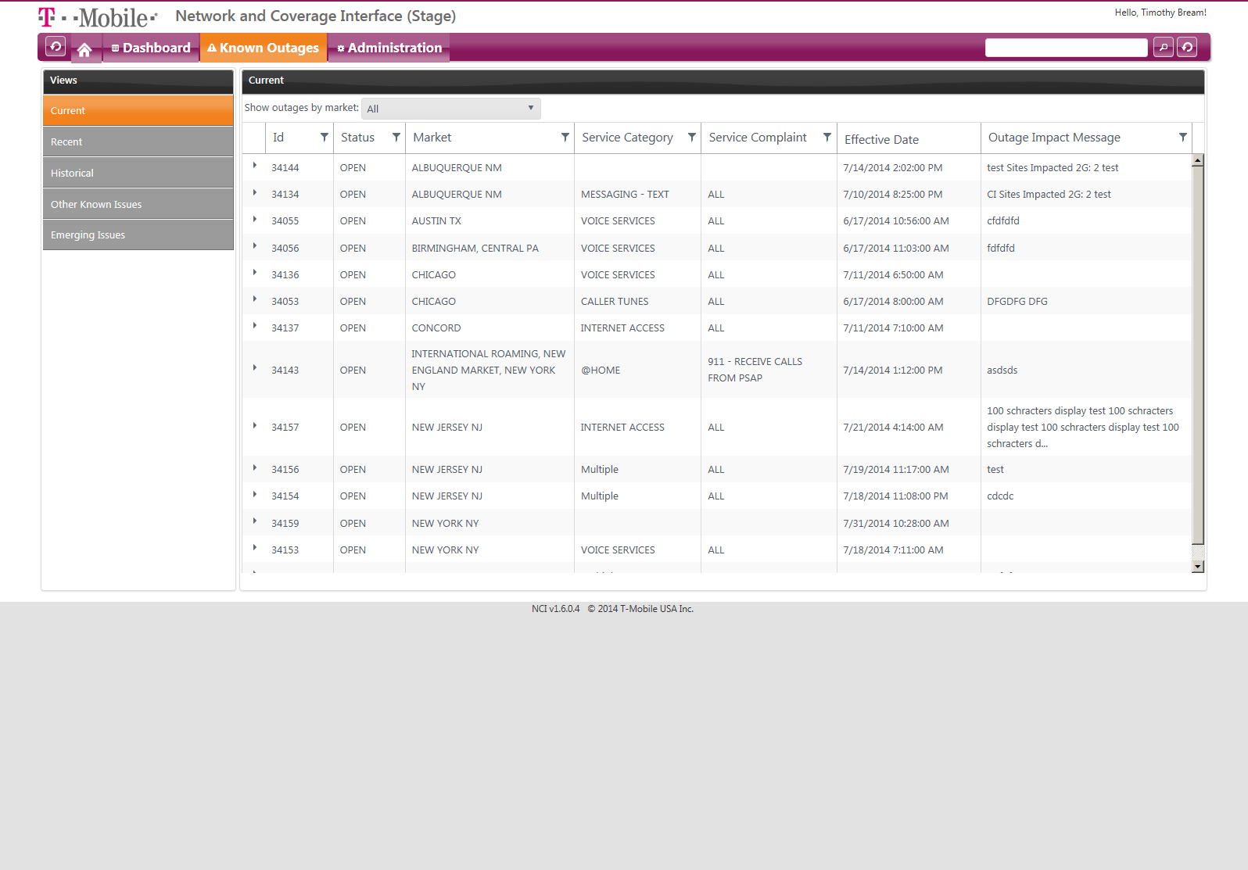
Notes:
Click Actions:
Recent: 62
Historical: Slide 61
Other Known Issues: Slide 63
Emerging Issues: Slide 64
Home: Slide 54

Slide 60
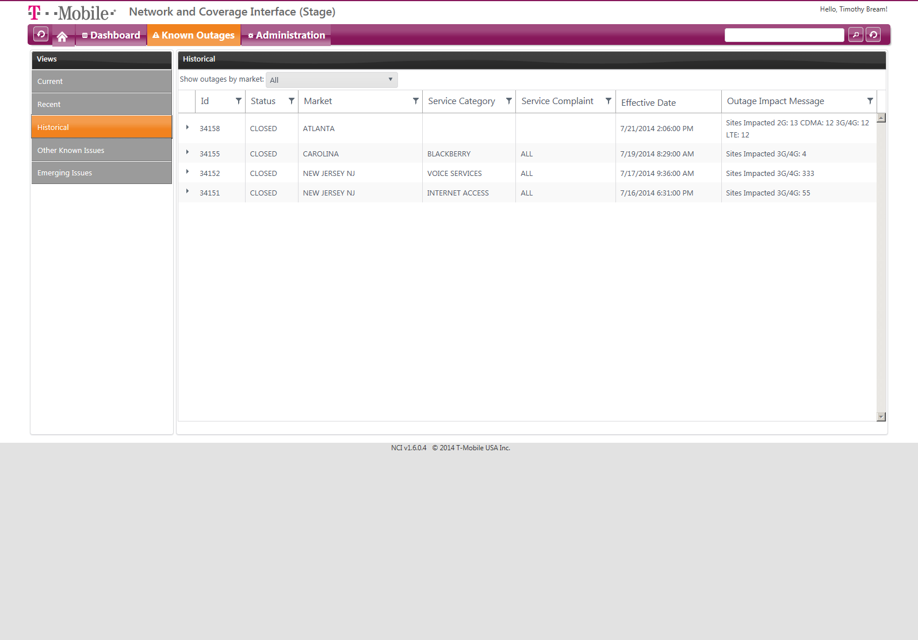
Notes:
Click Actions:
Recent: 62
Historical: Slide 61
Other Known Issues: Slide 63
Emerging Issues: Slide 64
Home: Slide 54

Slide 61
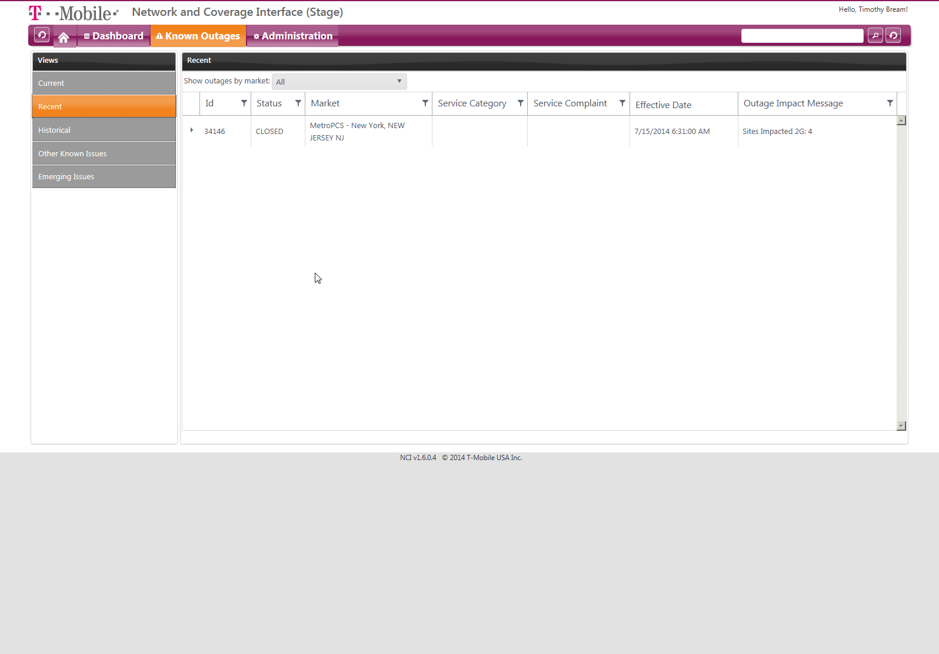
Notes:
Click Actions:
Recent: 62
Historical: Slide 61
Other Known Issues: Slide 63
Emerging Issues: Slide 64
Home: Slide 54

Slide 62
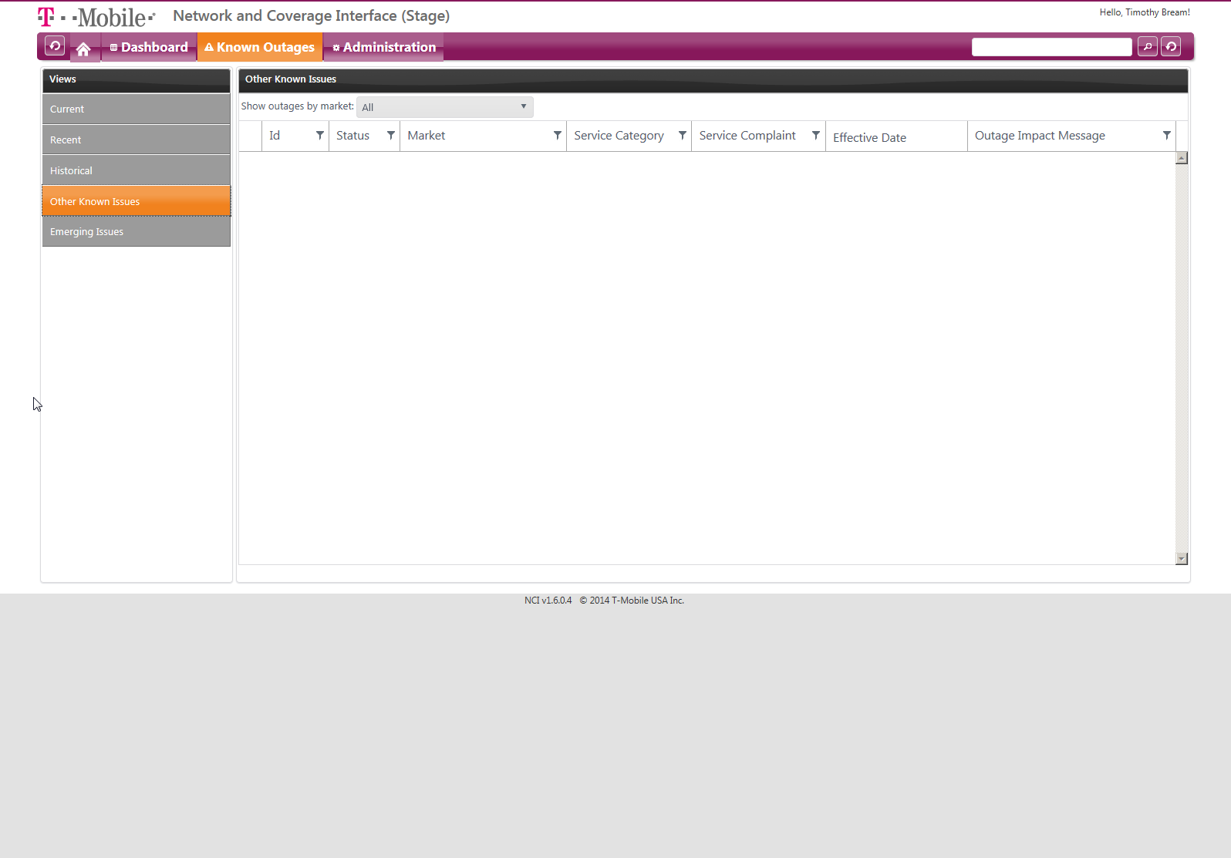
Notes:
Click Actions:
Recent: 62
Historical: Slide 61
Other Known Issues: Slide 63
Emerging Issues: Slide 64
Home: Slide 54

Slide 63
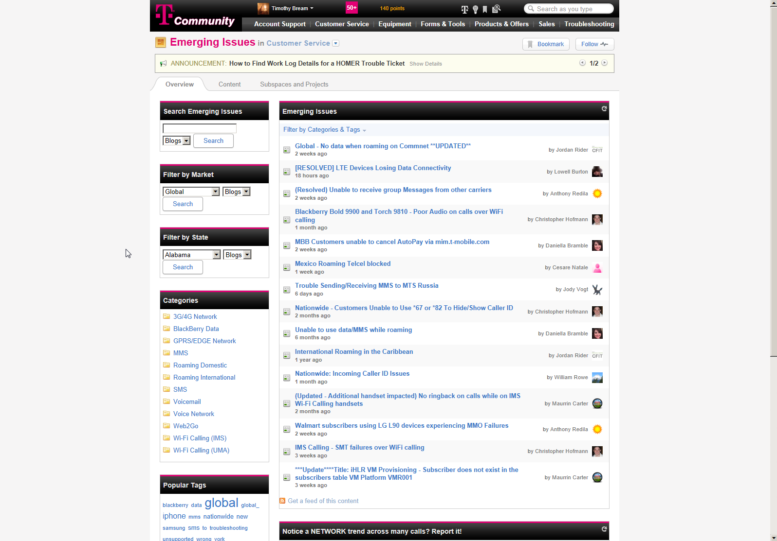
Notes:
Click Actions:

Slide 64
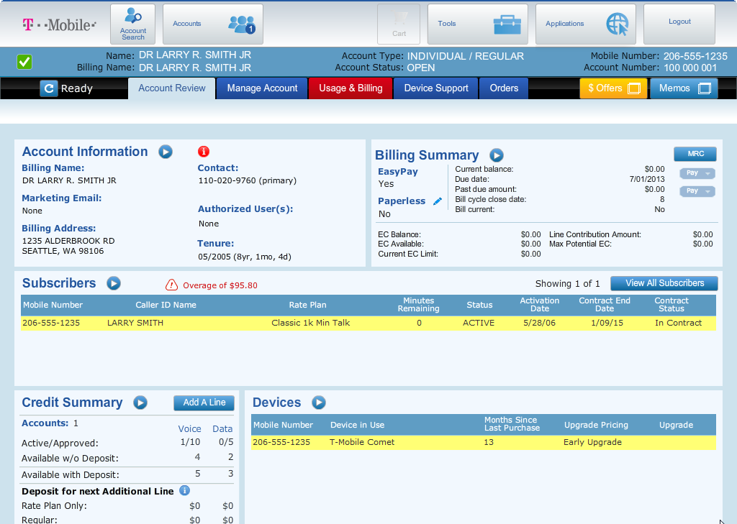

Slide 65
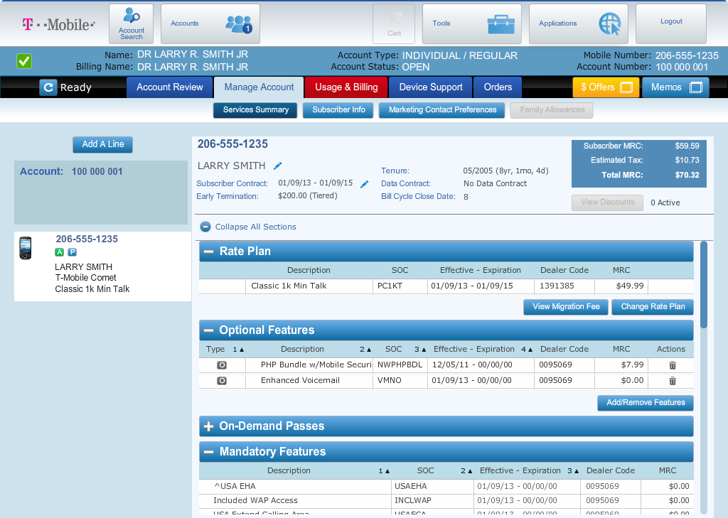

Slide 66
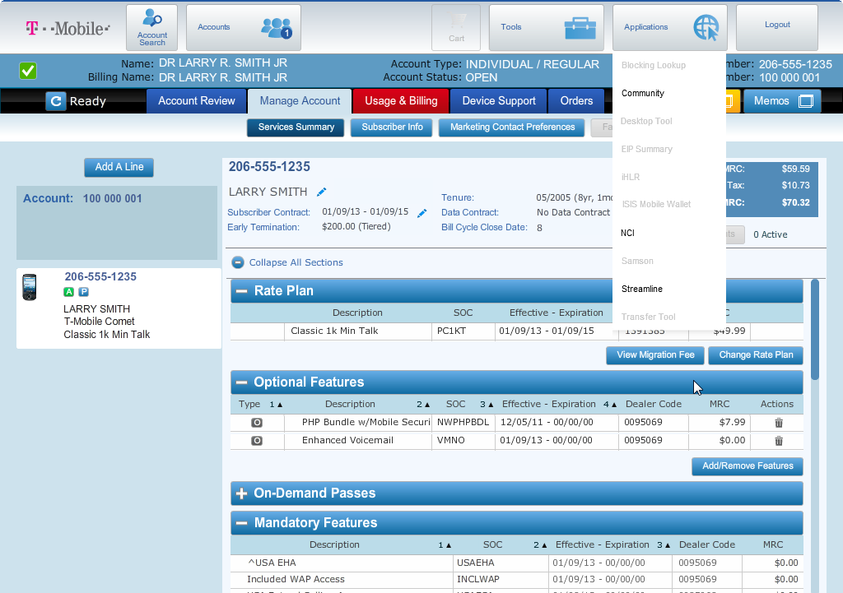

Slide 67
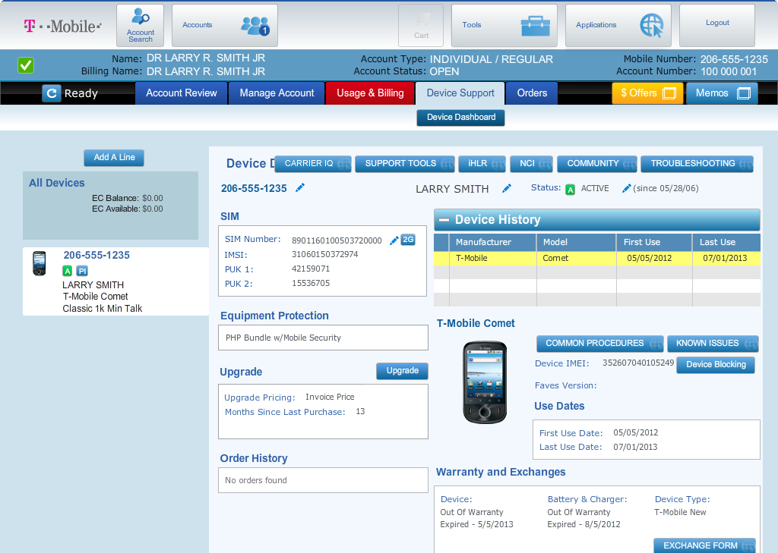

Slide 68
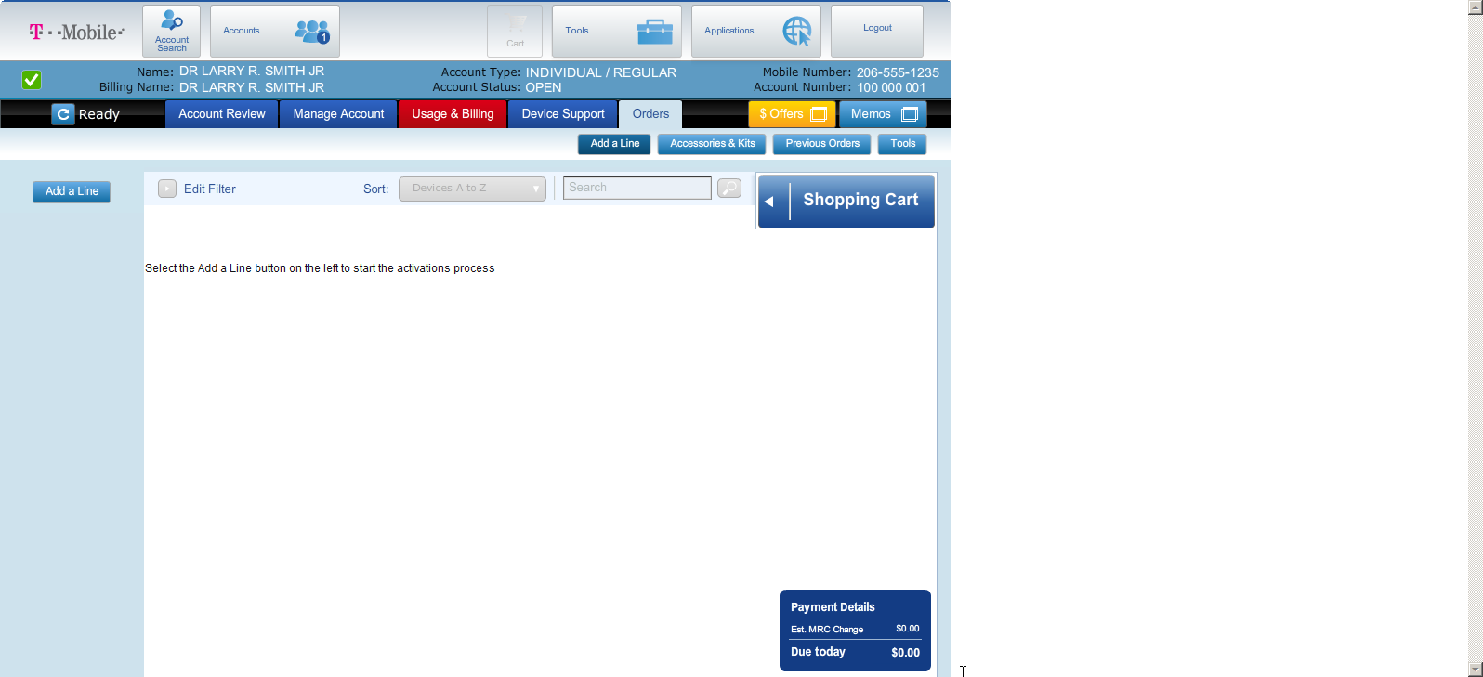

Slide 69
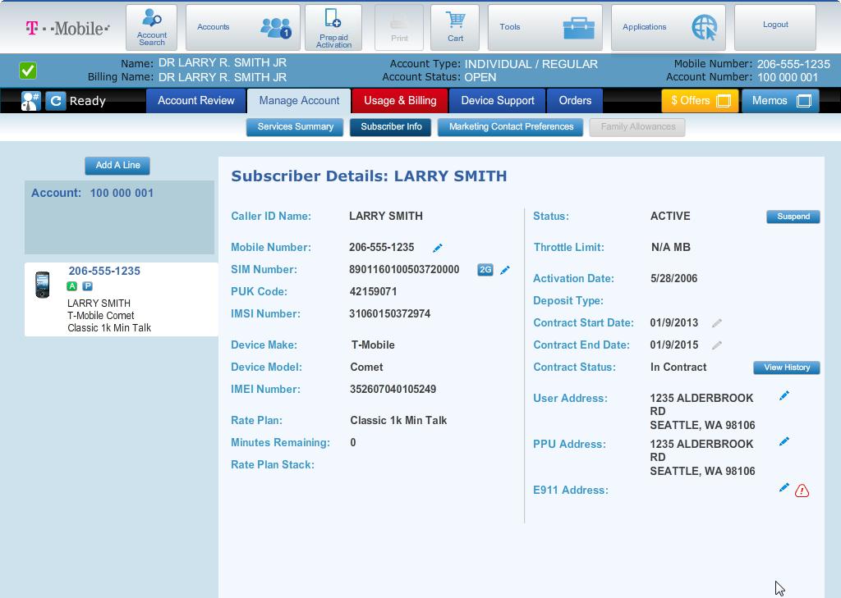

Slide 70
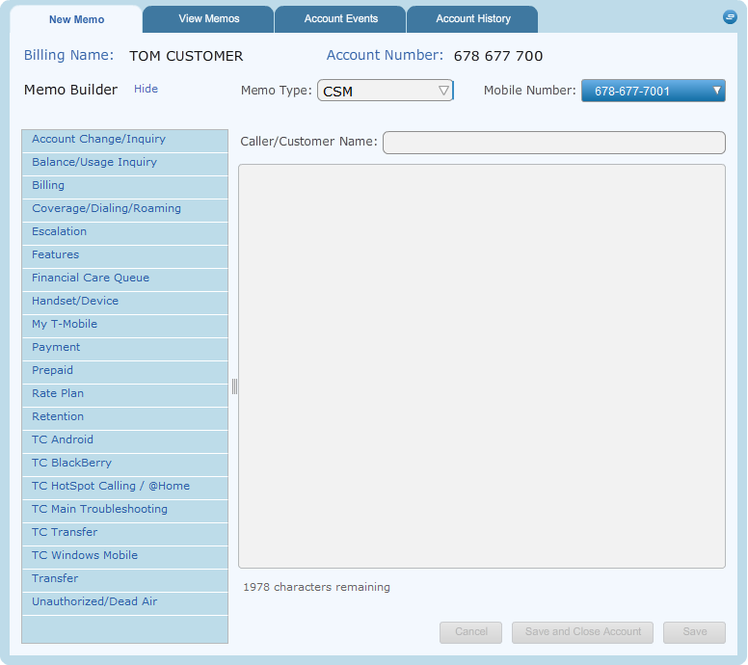

Slide 71
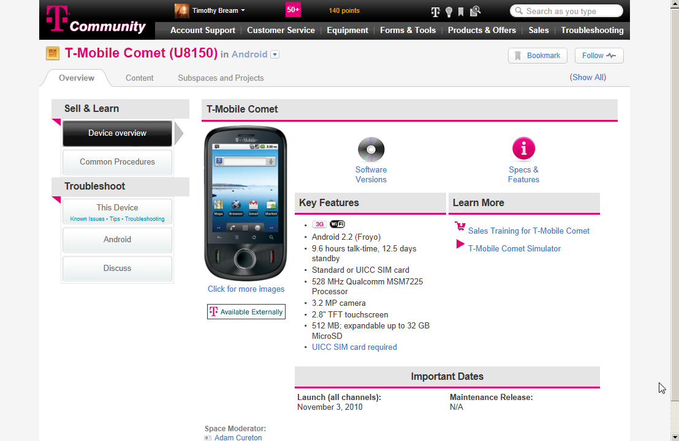

Slide 72
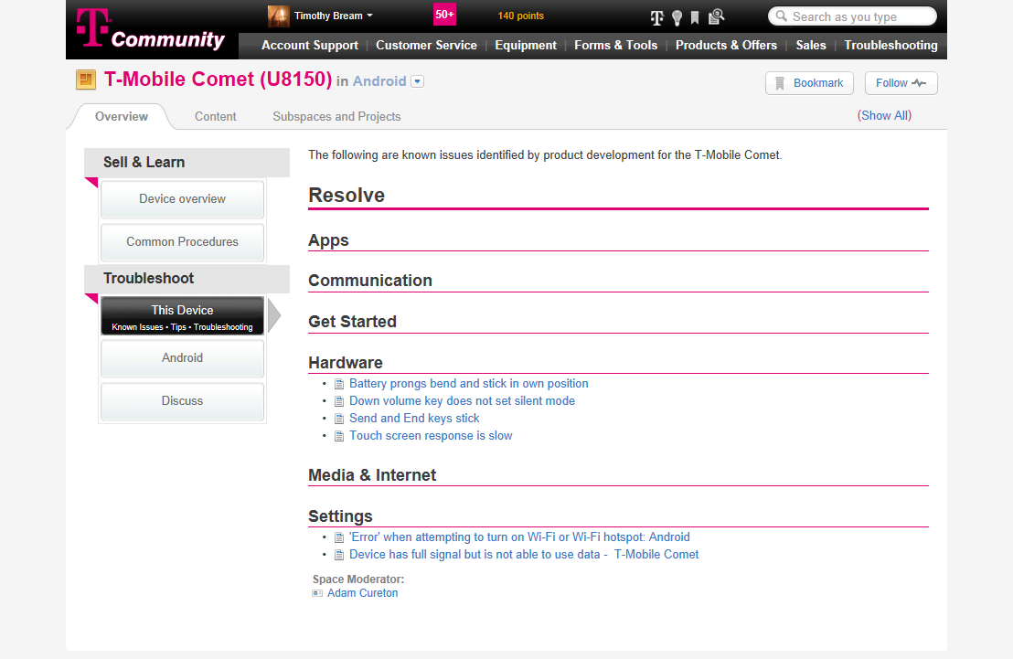

Slide 73
What screen would you like to view?
Feedback: Sorry, that selection will not provide any additional information to help solve this type of problem.
Keep in mind the possible root cause of the customer issue. If you don’t understand the issue fully, you may need to ask some questions. See if there is someone that can help.
Previous
Wrong Selection - QuikView Screen
Next
Notes:
Click Actions:
Previous – Proceed to the previous screen
Next – Proceed to the next screen

Slide 74
What screen would you like to view?
Answer Selected – Memos
Feedback: Memos is a great choice. Since this customer had this issue in the past, you will be able to get a better idea of identifying if this is related to a previous issue.
If this reason surprises you, it may be because you missed a question that you could have asked your witness. If asked if they experienced this issue before, the person would have told you they have had a similar issue in the past.
Previous
Correct Selection - QuikView Screen
Next
Notes:
Click Actions:
Previous – Proceed to the previous screen
Next – Proceed to the next screen

Slide 75
What screen would you like to view?
Answer Selected – Account Status
Feedback: Account status can help identify a suspension. This can cause only outgoing calls to be suspended (Ladex) or complete suspension (non-payment, lost and stolen).
If this reason surprises you, it may be because you missed a question that you could have asked your witness.
Previous
Correct Selection - QuikView Screen
Next
Notes:
Click Actions:
Previous – Proceed to the previous screen
Next – Proceed to the next screen

Slide 76
What screen would you like to view?
Answer Selected – Handset Dashboard
Feedback: Handset dashboard can be used to confirm the device the customer is using and ensure proper steps are followed for common procedures.
If this reason surprises you, it may be because you missed a question that you could have asked your witness.
Previous
Correct Selection – Handset Dashboard
Next
Notes:
Click Actions:
Previous – Proceed to the previous screen
Next – Proceed to the next screen

Slide 77
What screen would you like to view?
Feedback: Sorry, that selection will not provide any additional information to help solve this type of problem.
Keep in mind the possible root cause of the customer issue. If you don’t understand the issue fully, you may need to ask some questions. See if there is someone that can help.
Previous
Wrong Selection - Samson Screen
Next
Notes:
Click Actions:
Previous – Proceed to the previous screen
Next – Proceed to the next screen

Slide 78
What section would you like to view?
Feedback: Sorry, that selection will not provide any additional information to help solve this type of problem. Although it may be good to view this information as part of your overall visual audit, it would not impact the customers stated issue.
Keep in mind the possible root cause of the customer issue. If you don’t understand the issue fully, you may need to ask some questions. See if there is someone that can help.
Previous
Wrong Selection - iHLR Screen
Next
Notes:
Click Actions:
Previous – Proceed to the previous screen
Next – Proceed to the next screen

Slide 79
What section would you like to view?
Feedback: Sorry, that selection will not provide any additional information to help solve this type of problem. Although it may be good to view this information as part of your overall visual audit, it would not impact the customers stated issue.
Keep in mind the possible root cause of the customer issue. If you don’t understand the issue fully, you may need to ask some questions. See if there is someone that can help.
Previous
Wrong Selection – NCI Screen
Next
Notes:
Click Actions:
Previous – Proceed to the previous screen
Next – Proceed to the next screen

Slide 80
What section would you like to view?
Feedback: Sorry, that selection will not provide any additional information to help solve this type of problem. You would not view this tool unless there was a secondary issues that required you to do so after solving this problem.
Keep in mind the possible root cause of the customer issue. If you don’t understand the issue fully, you may need to ask some questions. See if there is someone that can help.
Previous
Wrong Selection – Desktop Tool Screen
Next
Notes:
Click Actions:
Previous – Proceed to the previous screen
Next – Proceed to the next screen

Slide 81
What section would you like to view? iHLR Cancel Location selection
Feedback: This is an accurate step, however after rebooting the device, the issue is not resolved.
Previous
Right Selection – iHLR Cancel Location Screen
Next
Notes:
Click Actions:
Previous – Proceed to the previous screen
Next – Proceed to the next screen

Slide 82
Script: We need to decide if we are going to return to ask more questions or make your way to the safe.
Scene 12 – Leaves room and makes way to safe

Slide 83
Are there any additional questions you want to ask our witness or are you ready to crack the code?
Computer
Previous
Computer Scene
Next
Notes:
Previous – Proceed to the previous screen
Next – Proceed to the next screen
Scene Notes: Helper will come back into the screen when all the necessary steps have been completed to identify a Service Request is needed. Scene will show the entire room like when they first entered the room.

Slide 84
Hurry the safe is in here.
Previous
Hallway Scene – 2nd Safe
Next
Notes:
Click Actions:
Previous – Proceed to the previous screen
Next – Proceed to the next screen
Scene Notes:
Helper will be leading the user down the hallway to the safe… Add in noise like desk falling over, things being thrown on the floor and make them louder as they get close to the door.

Slide 85
Script: Here’s the safe. We’re running out of time. We need to organize our thoughts. The customer is having a problem with problem here. What are some of the potential problems based on the description?
Scene 13 – Safe and whiteboard with clue information

Slide 86
Here’s the safe. We’re running out of time. We need to organize all the information we’ve gathered. The customer is having a problem with coverage. To open the safe we have to determine the root cause.
Questions and Answers
Computer Scene Information
Safe
Root Cause
Previous
Safe Scene
Next
Notes:
Click Actions:
Questions and Answers: Slide
Computer Scene Information: Slide
Root Cause: Slide
Scene Notes:
This scene will contain the safe and a room in the background. This room should have the look like it is locked down and hard to get into. The safe will require the user to identify the root cause. They can click on the other boxes to view all the old information. They will need to select the right combination. After the selection the combination will spin and either open or NOT open the safe. The safe will only open when the correct root cause is selected.

Slide 87
Script: What’s causing the root cause of the problem that’s causing him to insert problem
Scene 14 – Safe and whiteboard with clue information

Slide 88
Activity Screen where the CSR will choose from different root causes
Scene XX – Safe and whiteboard with clue information

Slide 89
Script: You’ve cracked the code!!!! We need to get the key back to the leader quick.
Scene 15 – Safe opened with key inside (root cause – solution logo of some sort)

Slide 90
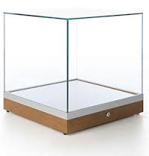
You’ve cracked the code!!!! We need to get the key back to the leader quick.
Safe with open door and inside is the key
Previous
Opened Safe with Key Scene
Next
Notes:
Click Actions:
Previous – Proceed to the previous screen
Next – Slide
Scene Notes:
The safe will open and contain a Hotel looking like key as described in the mission details slide. The key will be in this glass case inside the safe. The image will be of the safe with the door open, key inside and room in the background. The agent will have his hand reach in the scene for the key and go off the screen.

Slide 91
Hallway with doors at end
Previous
Hallway Scene – 2nd Safe
Next
Notes:
Click Actions:
Previous – Proceed to the previous screen
Next – Proceed to the next screen
Scene Notes:
This scene will show the agent and his helper agent running down the hall way with the 3 doors in the next screen getting closer and closer until they reach the doors.

Slide 92
Script: One of these doors leads to the way out. We can only pick one.
Scene 16 – 3 Doors with solution written on them

Slide 93
Instructions: You can only pick one door. The correct door is one that offers a permanent solution for the customer. If you choose a solution that offers a temporary solution or doesn’t offer a solution, the country will be taken over.
Scene 17 – 3 Doors with solution written on them

Slide 94
Instructions: You’ve reach the door to the city. You can only pick one door. The correct door is the one that will solve the customers issue long term. If you feel there are multiple solutions that will work long term, you may not fully understand the issue. You can go back to previous sections to gather more information if needed.
Door
Solution: Send to Technical Care
Door
Solution: Complete Service Request
Door
Solution: Complete Handset Exchange
Witness Information
Computer Room
Previous
Door Scene
Notes:
Click Actions:
Door 1:
Door 2: Proceed to slide
Door 3:
Scene Notes:
During this scene, the agent will be at the end of the hallway with the 3 doors to choose from. They should have the electronic key lock on the handle. The door can look shiny like an elevator doors as if they were made of steel. Maybe would be good if the agent could look small in this scene and the doors look extra big. Once the right door is selected, the door will open and the following scene will appear as the agent moves through the door to the city with his helper agent.

Slide 95


Script: You’ve saved us all agent name. We couldn’t have done it without you.
Scene 18 – Happy Tmobile land (image of people with magenta clothing and magenta themed area jumping for joy

Slide 96
Building
Building
Building
Agent name, you did it. You saved the city from corruption. You are the only agency that keeps the customer in mind. Thank you!
Building
Building
Coaching Screen
Magenta Scene
Notes:
Previous – Proceed to the previous screen
Next – Proceed to the next screen
Scene Notes:
It would be awesome if we could mimic the style of buildings we see in some commercials where the buildings are black and the windows are in magenta. It would be cool if we could also add something as if there were a light shining up in the sky like in batman and it would have a t-mobile logo in it. In the scene, a random person would be saying that they saved the world. It could be the same random person from the beginning of the training that asked him to help save the city.

